Slide 1
The Galactic Center Excess:
NMSSM Interpretation
Nausheen R. Shah Wayne State University
C. Cheung, M. Papucci, D. Sanford, and K. Zurek, PRD90 (2014) 7, 075011 [arXiv:1406.6372]

Slide 2
Outline
Thermal Dark Matter Relic Density (Ωh²)
Galactic Center Excess (GCE)
Simplified Model: GCE + Ωh² ?
NMSSM
GCE + Ωh² in the NMSSM

Slide 3
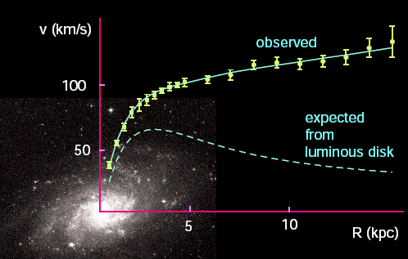
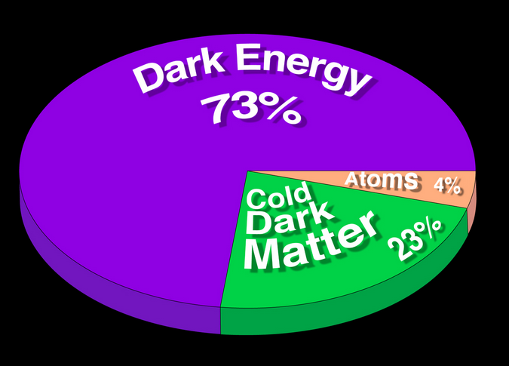
Welcome to the Dark Side!
Wikipedia
http://cosmology.berkeley.edu/Education/CosmologyEssays/Why_Dark_Matter.html
We know both A LOT and VERY LITTLE about Dark Matter
Experimental Observation: Ωh² = 0.1188 ± 0.0011
Planck 2015

Slide 4
Welcome to the Dark Side!
What is Dark Matter?
Is not colored or charged
Interacts gravitationally
Could interact weakly
Stable on Universe lifetime scales
More than one DM species?
Higgs Interactions?
Neutrinos?? Too Hot: No Structure formation
Wikipedia
We know both A LOT and VERY little about Dark Matter
We know both A LOT and VERY LITTLE about Dark Matter
Experimental Observation: Ωh² = 0.1188 ± 0.0011
Experimental Observation: Ωh² = 0.1188 ± 0.0011
Planck 2015

Slide 5
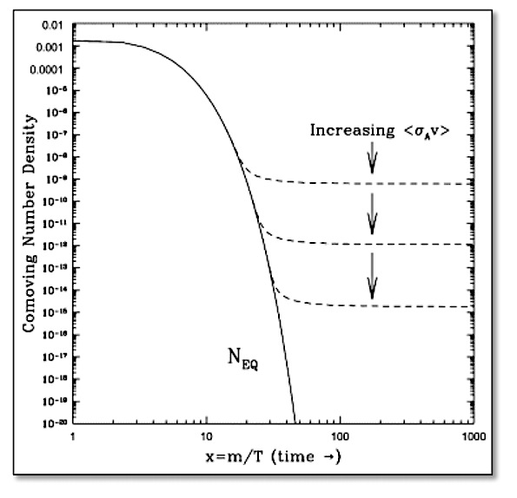
Thermal Relic?
What sets the abundance of the Dark Matter observed?
Solve Boltzmann Eq.
Annihilations try to maintain thermal equilibrium.
Universe is Expanding!
At some point a DM particle can’t “find” another DM particle to annihilate with: FREEZE-OUT.
LARGER annihilation rate means LOWER number density.
Hooper, 09

Slide 6
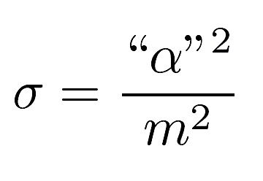
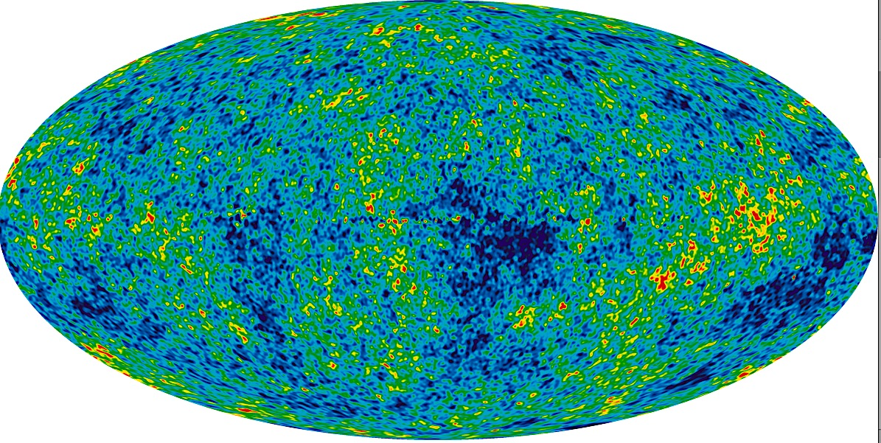
The WIMP Miracle.
Planck 2015
Interestingly, the annihilation cross-section required to give rise to an observationally consistent relic density is naturally of the right order given weak scale couplings and masses (100 GeV) !

Slide 7
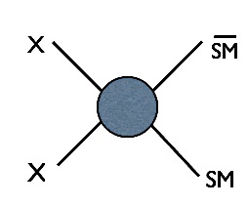
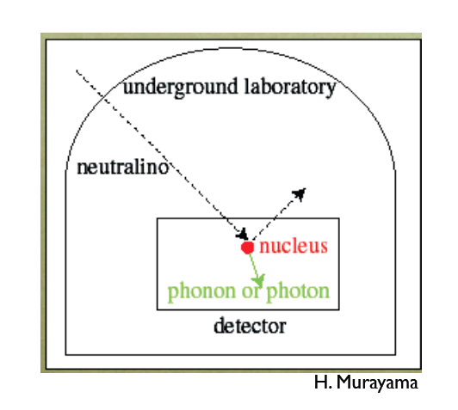
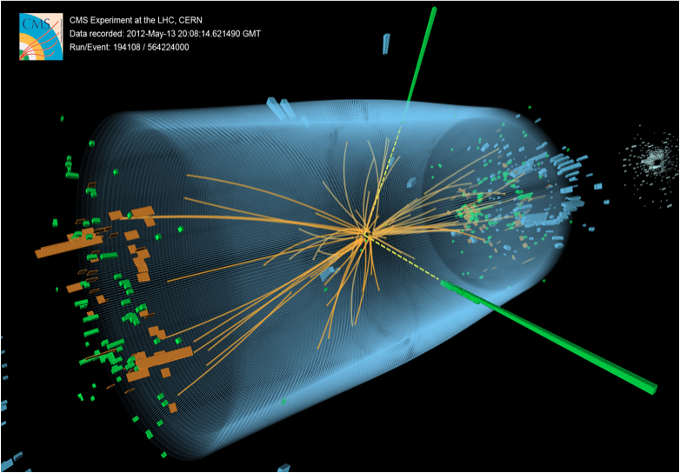
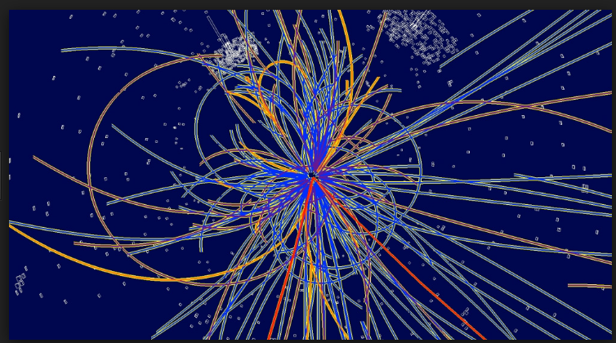
Trouble in Paradise?
Crossing symmetry: Relic Density ↔ Direct Detection
Annihilation
Scattering
Collider
Stringent scattering cross-sections limits from LUX/XENON100

Slide 8
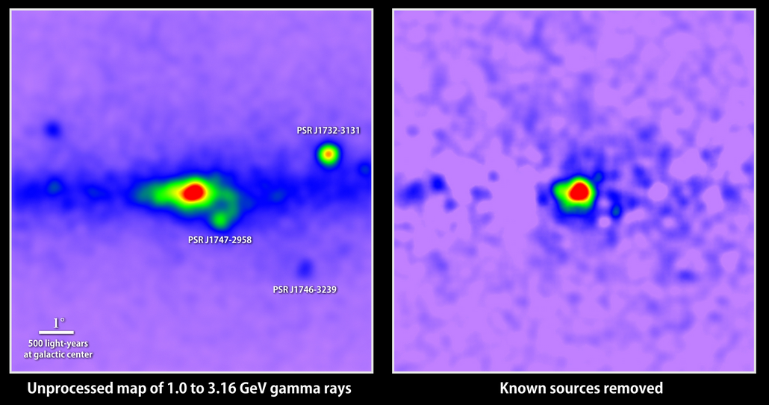
The Galactic Center Excess.
Excess observed in photons with energies of a few GeV coming from the Galactic Center (Fermi LAT).

Slide 9
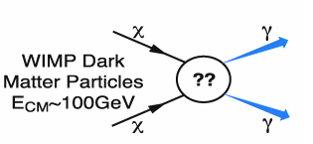
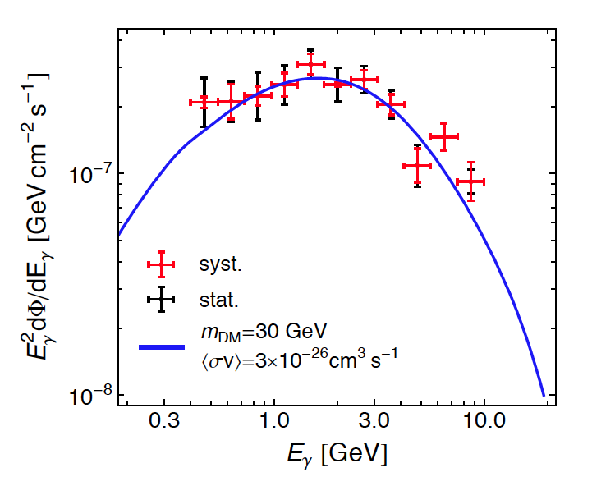
Galactic Center Excess: What is it?
Large Astrohphysical uncertainties.
Particle physics interpretation?
→ Predictions?
resonaances.blogspot.com
C. Boehm, M. J. Dolan, C. McCabe, M. Spannowsky, C. J. Wallace, 14
Annihilation of DM present in over-dense regions of the universe, like the Galactic Center, could produce a detectable signal in the photon flux.
Distinctive bump like spectrum.

Slide 10
Galactic Center Excess: What’s needed?
Nominal value for GCE (T~0) ~ Relic Density (T_{F})
Cross-section must be dominantly “s-wave” – not T dependent.
γ
DM
SM
γ
mediator
γ
CP-odd scalars could be good mediators:
s-wave cross-section
No SI direct detection
DM
SM
γ
First Step:
Requirements of GCE and relic density in a simplified model.
DM ~ 30 – 40 GeV
Annihilating to bb

Slide 11
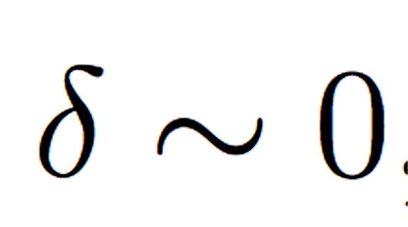
Simplified Model
Consider arbitrary CP-odd scalar “a” as mediator.
Resonant Annihilation can cause significant complications.
2m_{χ}~ m_{a}
Thermal fluctuations at the time of freeze-out would push the energy closer to resonance than at zero temperature.
(Griest & Seckel, ‘91)
Very fine tuned relationships required between masses and couplings to satisfy both GCE and relic density.

Slide 12
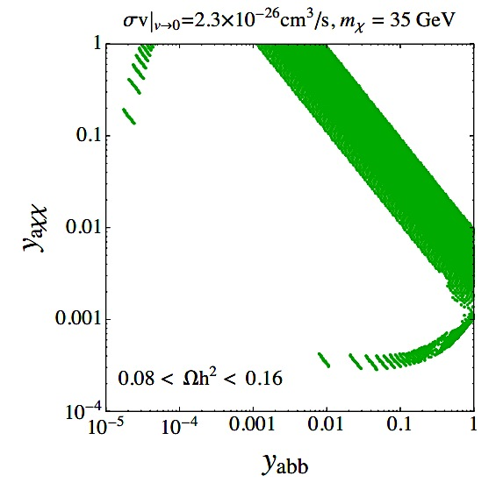
Simplified Model: Results.
Non-resonant:
Ωh² + GCE: y_{abb}² y_{axx}²
Close to resonance:
Ωh² : smaller of y_{abb}² and y_{axx}² δ/6
GCE: larger of y_{abb}/y_{axx} and y_{axx} δ/6 y_{abb}
Non-resonant
resonant
Smaller coupling ~ 10⁻³
Ratio of coupling ~ 10⁻³
MSSM: Light A strongly constrained from direct searches.
NMSSM :Both resonant and Non-resonant annihilation possible.
C. Cheung, M. Papucci, D. Sanford, N. R. S and K. Zurek, ‘14

Slide 13
GCE + Ωh² ↔ LHC.
γ
Ωh²
T_{F}
χ
γ
a
b
χ
γ
b
χ
GCE
T ~ 0
b
a
γ
χ
b
g
l/q
a
LHC?
Relate to h125?
g
l/q

Slide 14
Supersymmetry

Slide 15
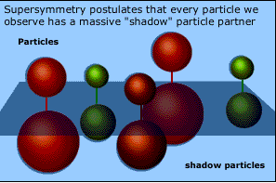
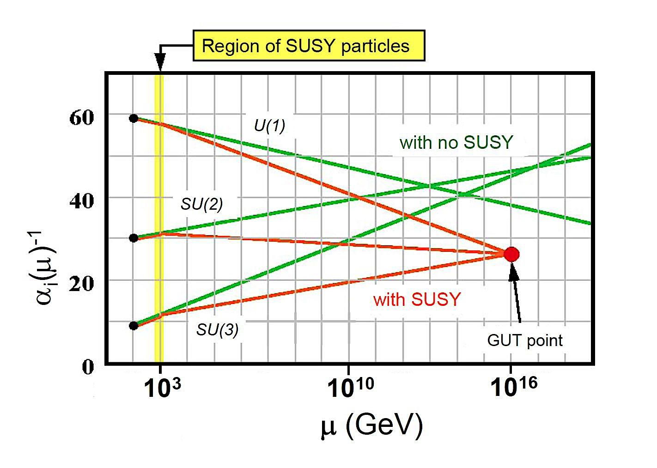
Supersymmetry:
Explains hierarchy between the EW scale and the Planck/unification scales.
Generates electroweak symmetry breaking (EWSB).
Allows unification of electroweak and nuclear forces at energies ~10¹⁶ GeV.
Provides a good dark matter candidate: The Lightest SUSY Particle (LSP)

Slide 16
Minimal Supersymmetric SM (MSSM).
For every fermion there is a boson of equal mass and couplings and visa versa.
DM: Gauginos + Higgsinos
No new couplings.
SUSY has to be broken.
Need 2 Higgs doublets:
H_{u} – Couples only to up-type quarks
H_{d} – Couples only to down-type quarks and leptons.
m_{A} ~ m_{H}
tan β = v_{u} /v_{d}

Slide 17
Next to Minimal Supersymmetric SM (NMSSM).
m_{A}
m_{a}/m_{hS}
2 Doublets (H_{u}, H_{d}) + Singlet (S)
Singlet couples only to the Higgs Sector.
Singlet acquires vev: μ = λ v_{s}
3 CP-Even Higgses: h, H, S
h ~ 125 GeV, h-H and h-S mixing
2 CP-Odd Higgses: a₂, a
Direct searches for A/H ->ττ and H⁺ -> τ ν
5 Neutralinos:

Slide 18
Galactic Center Excess
connections to the LHC
In the NMSSM

Slide 19
Neutralino Composition Wino Decoupled
Singlino-Higgsino
κ/λ << 1
Bino decoupled(M₁ large)
Higgsino comp ~ λv/μ
Light singlet-like scalar.
h125 SM-like:
m_{A} ~ 2|μ|/ s_{2β}
Bino-Higgsino
κ/λ >> 1
Singlino Decoupled
Higgsino comp ~ m_{z}s_{w}/μ
Singlet-like scalar heavy and decoupled
MSSM-like CP-even sector
Strongly mixed CP-odd sector.
H and a₂ not necessarily degenerate.

Slide 20
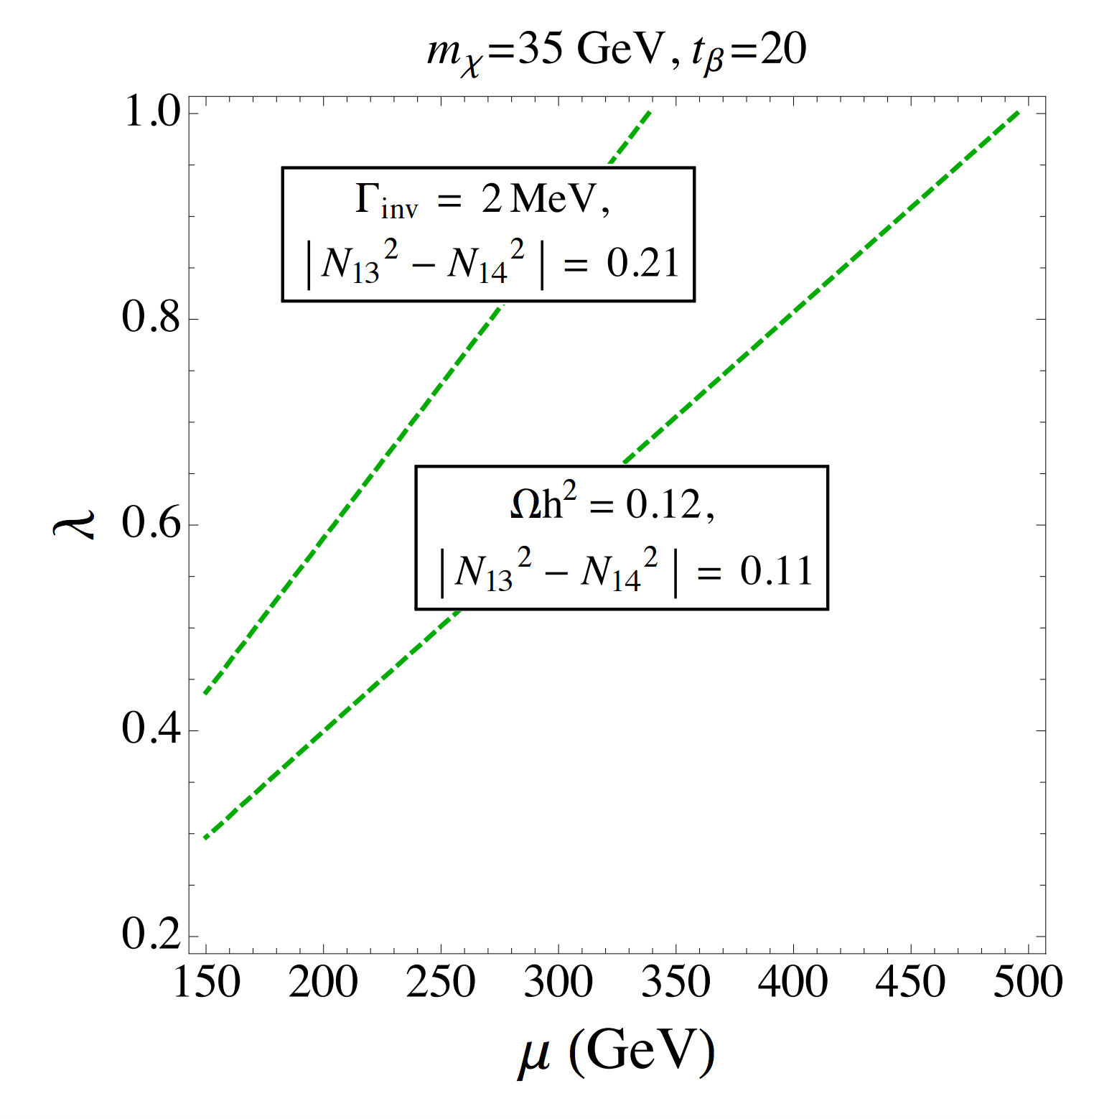
GCE in NMSSM. Singlino-Higgsino
Moderate / Large tan β
κ/λ <<1
Z couples to the Higgsino components
~cos 2β dependence
Z can contribute relic density
Invisible width of Z < 2 MeV
C. Cheung, M. Papucci, D. Sanford, N. R. S and K. Zurek, ‘14

Slide 21
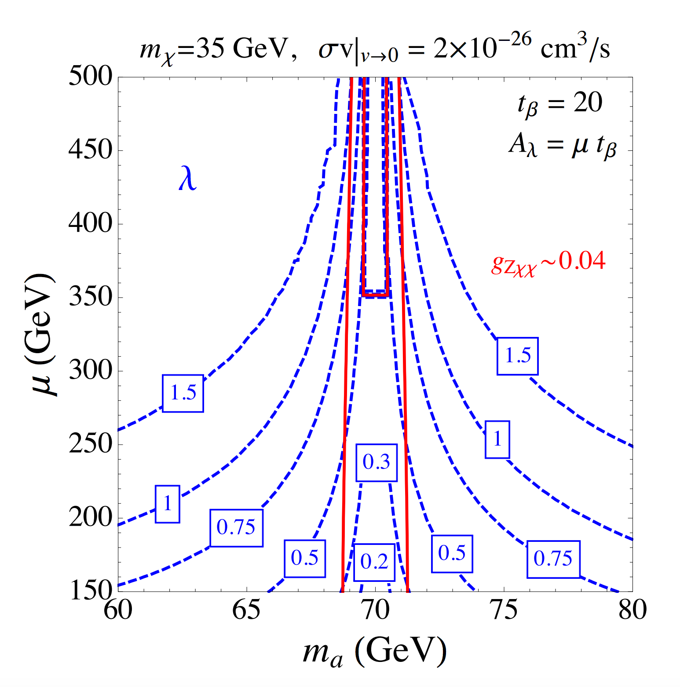
GCE in NMSSM. Singlino-Higgsino
Moderate / Large tan β
κ/λ <<1
Νο tan β enhancement of the abb coupling
Z can contribute relic density
Invisible width of Z < 2 MeV
Only allowed to live very close to resonance
C. Cheung, M. Papucci, D. Sanford, N. R. S and K. Zurek, ‘14

Slide 22
GCE in NMSSM. Singlino-Higgsino
Moderate / Large tan β
χ
H, h, S
n
κ/λ <<1
χ
n
Strong constraints from direct detection experiments.
3-way cancellation possible between h, H and S contributions

Slide 23
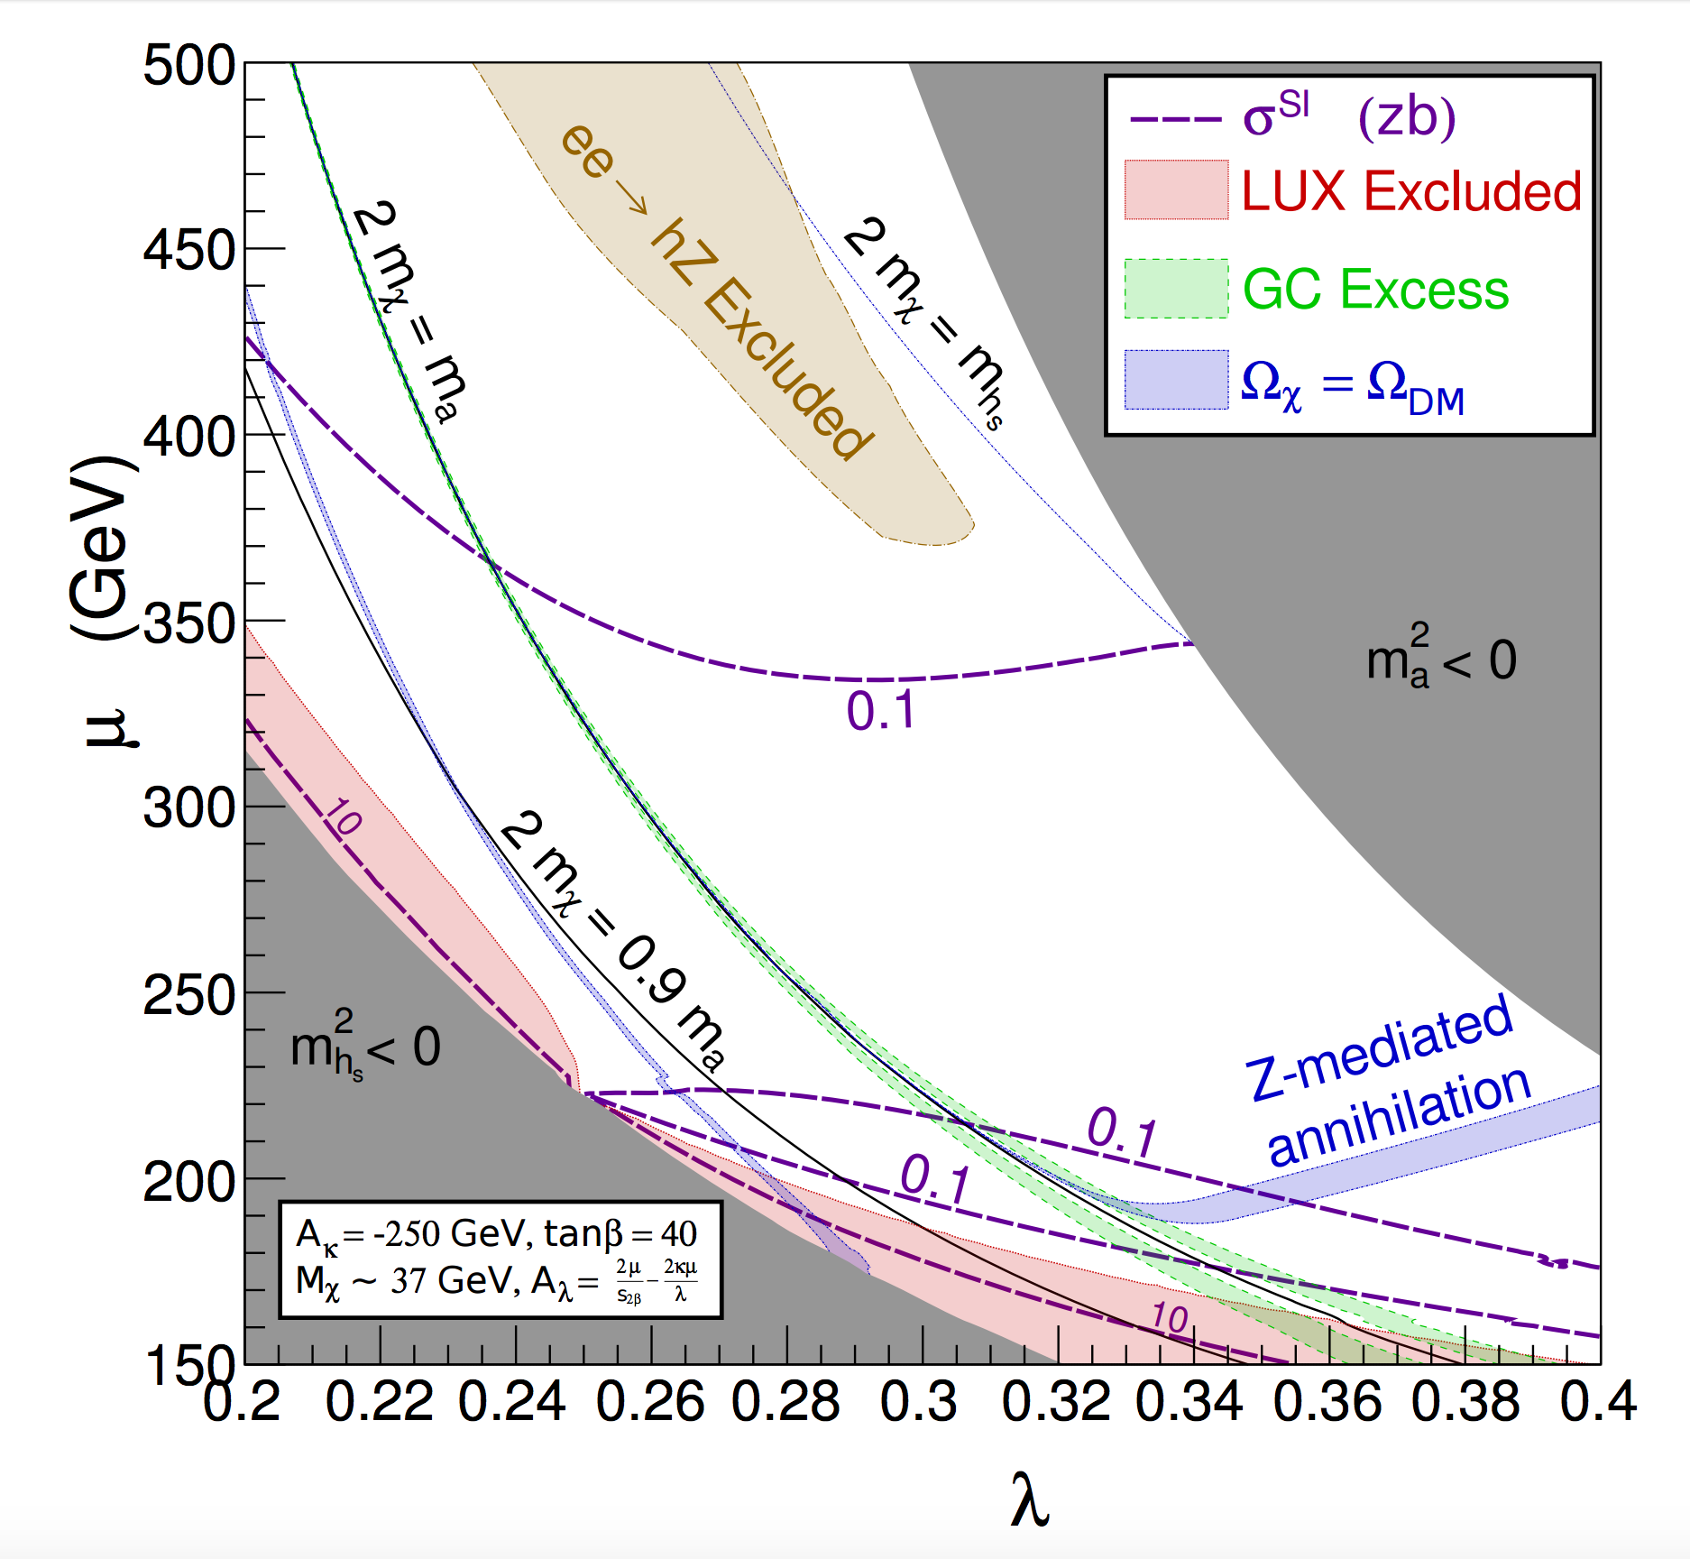
GCE in NMSSM. Singlino-Higgsino
Moderate / Large tan β
C. Cheung, M. Papucci, D. Sanford, N. R. S and K. Zurek, ‘14
κ/λ <<1
NMSSMTools Scan
m_{χ} ~ 37 GeV
h125: stop mass parameters.
h-S mixing: m_{A} ~ 2|μ|/ s_{2β}
2 m_{χ} < m_{a} : GCE discrepant with Ωh²
2 m_{χ} > m_{a} :GCE + Ωh² , with help from Z
Direct Detection: New LUX still far from probing.
Invisible decays of the Higgs may probe this region
Butter, Plehn, Rauch, Zerwas, Henrot-Versill´e, and Lafaye, ‘15

Slide 24
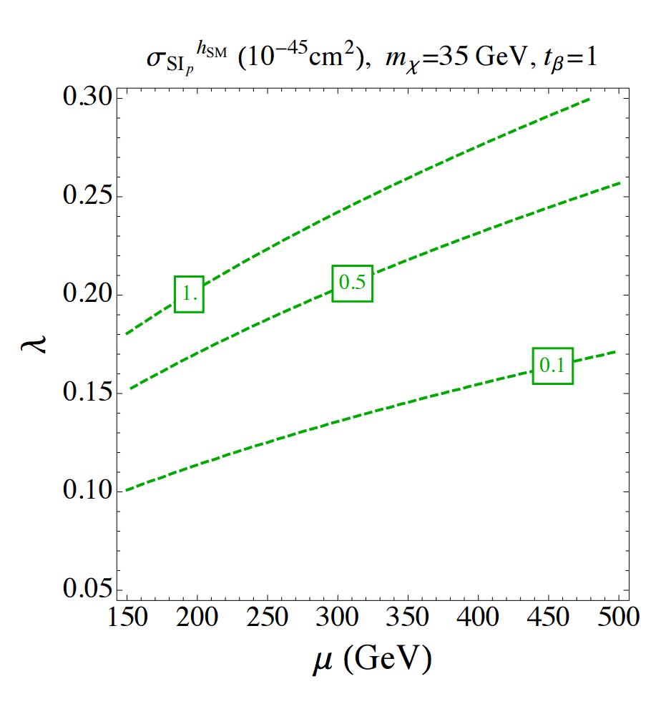
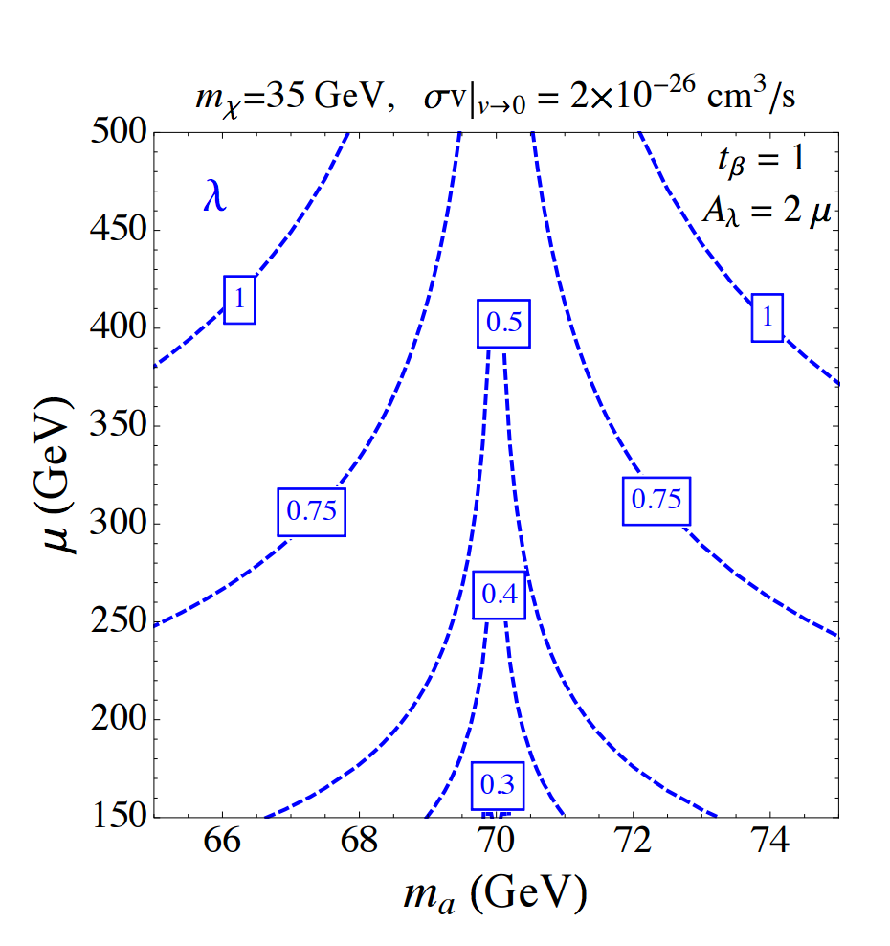
GCE in NMSSM. Singlino-Higgsino
tan β ~ 1
κ/λ <<1
No (v. weak) constraint from Z
h125 direct detection large
Blind-spot with h-S, λ < 0.3
ON-RESONANCE!!
Natural NMSSM disfavored!!

Slide 25
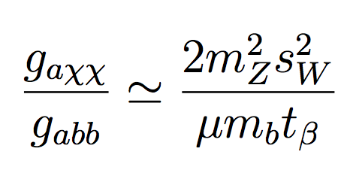
GCE in NMSSM. Bino-Higgsino
Moderate / Large tan β
κ/λ >>1
λ small
h125 only achievable via stops, as in MSSM
Much smaller Higgsino component
Z constraints negligible
abb coupling tan β enhanced
Non-resonant annihilation more natural

Slide 26
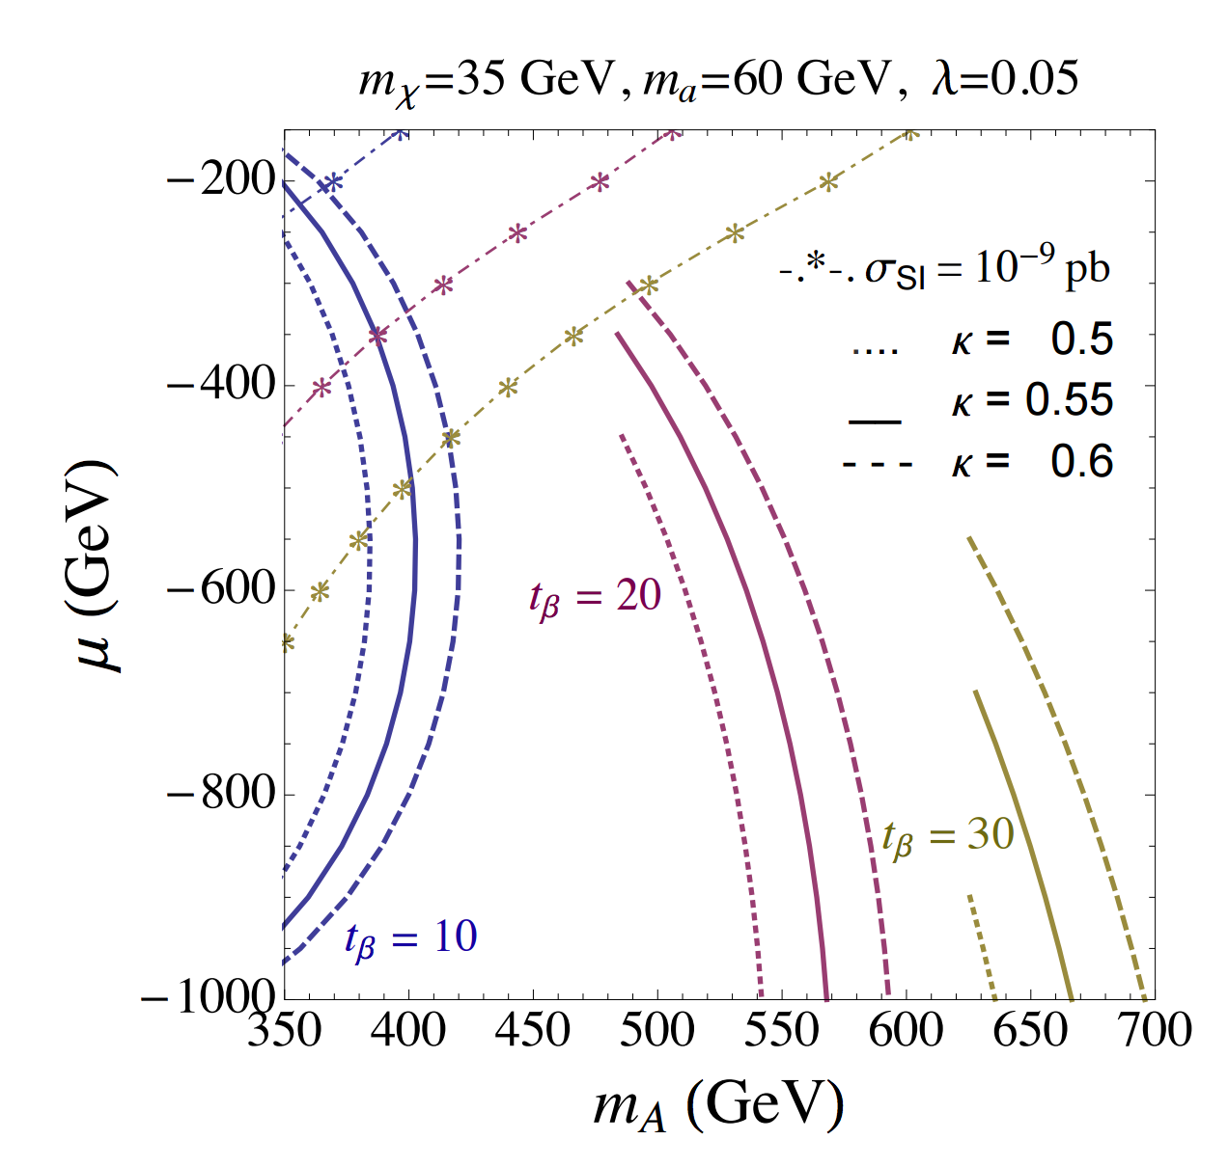
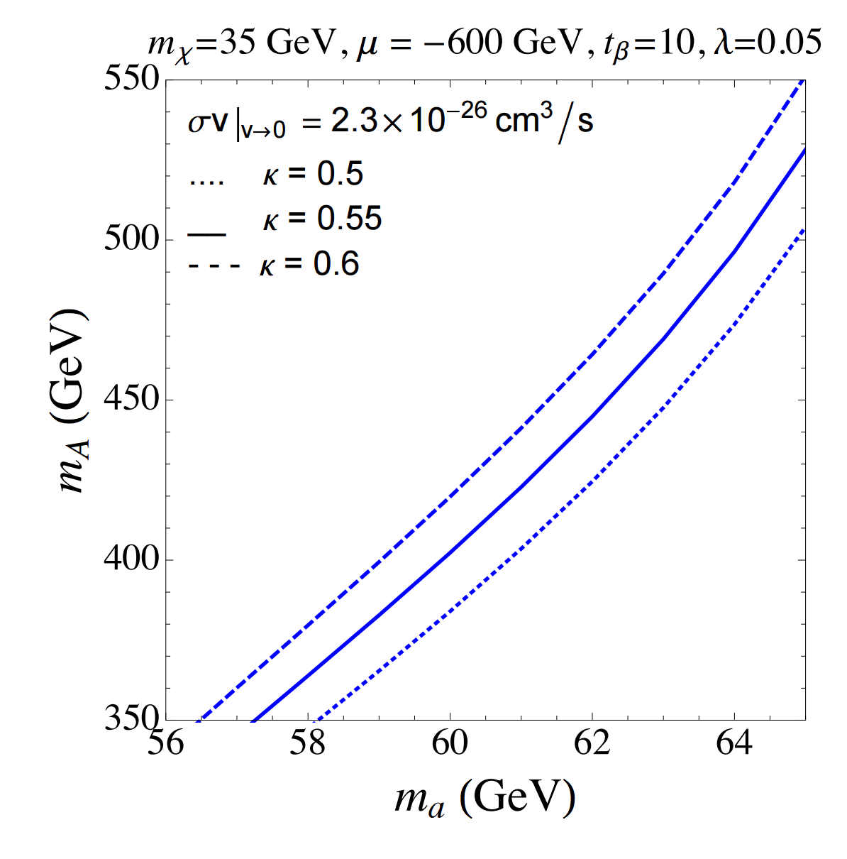
GCE in NMSSM. Bino-Higgsino
Moderate / Large tan β
κ/λ >>1
CP-even singlet heavy and decoupled
CP-odd sector heavily mixed
MSSM-like Direct detection via both h and H
Easy to evade bounds
abb tan β enhanced:
Easy to generate GCE + Ωh² off-resonance

Slide 27
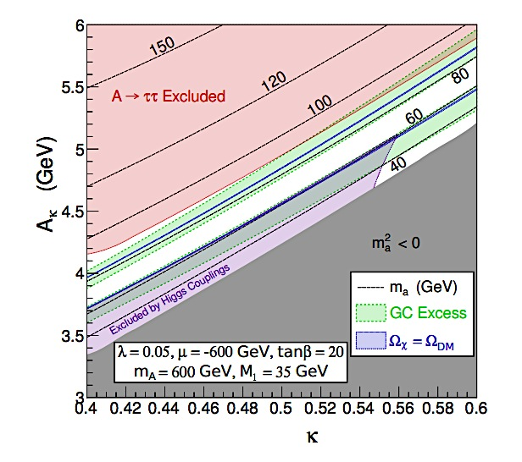
GCE in NMSSM. Bino-Higgsino
C. Cheung, M. Papucci, D. Sanford, N. R. S and K. Zurek, ‘14
NMSSMTools Scan
m_{χ} ~ 35 GeV
h125: stop mass parameters.
Consistent GCE+Relic Density for m_{a} ~ 60-90 GeV.
m_{A2}~ 500-700 GeV
m_{H} ~ 450 GeV
Interesting region for Higgs searches!
CP-odd sector heavily mixed:
H and A2 non-degenerate
LHC has no published searches below 90 GeV.
LEP limits evaded (no CP-even light Higgs)
m_{a} has significant active component (~ 50%)
Recent analysis: LHC13 should be able to probe this light pseudoscalar window.
J. Kozaczuk, T. A. W. Martin, ‘15

Slide 28
Conclusions and Outlook.
Could be unknown Astrophysical sources
GCE, What is it??
Could be DM particles annihilating
Simplified Model
Coupling and mass relations
NMSSM:
Many non-trivial constraints that need to be evaded/satisfied
Phenomenology depends on composition of Neutralino.
2 working examples: S/H and B/H
Data + Theory: Where to look next!
Future LHC:
Probe light pseudoscalar
Access small invisible decays of the h125

Slide 29
Thank you.

Slide 30
Backup
slides.

Slide 31
Resonant Annihilation

Slide 32
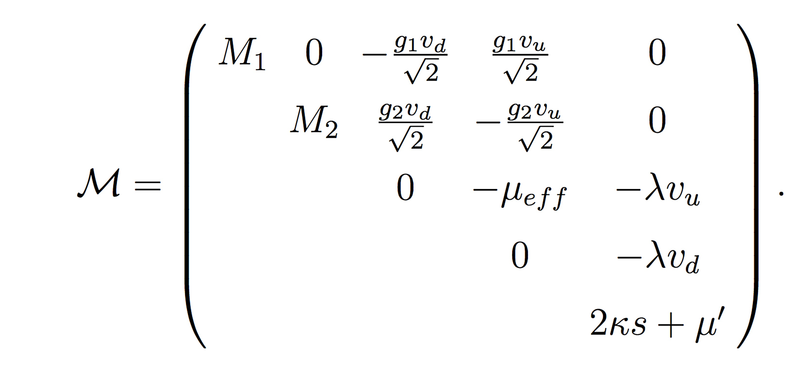
NMSSM Neutralinos.
Singlino mixes with the MSSM Neutralinos

Slide 33
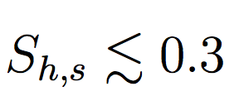
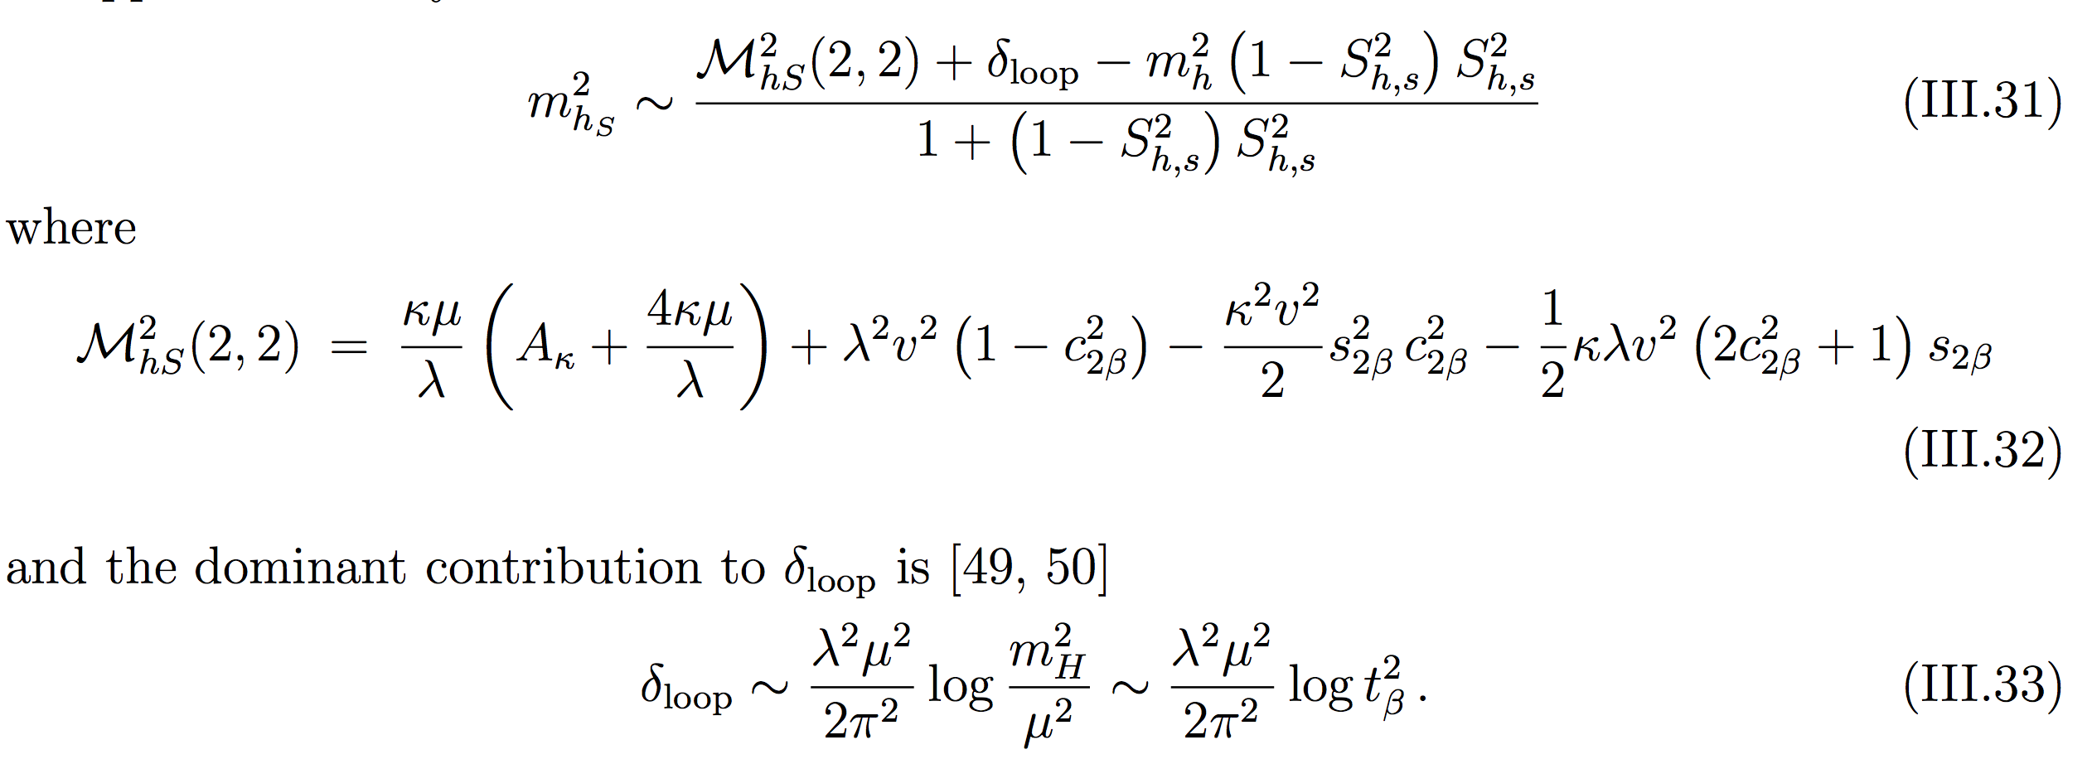
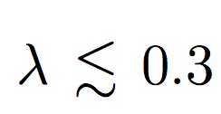
Singlino-Higgsino Blind spot tb~1

Slide 34
Flavor Bino-Higgsino

