Slide 1
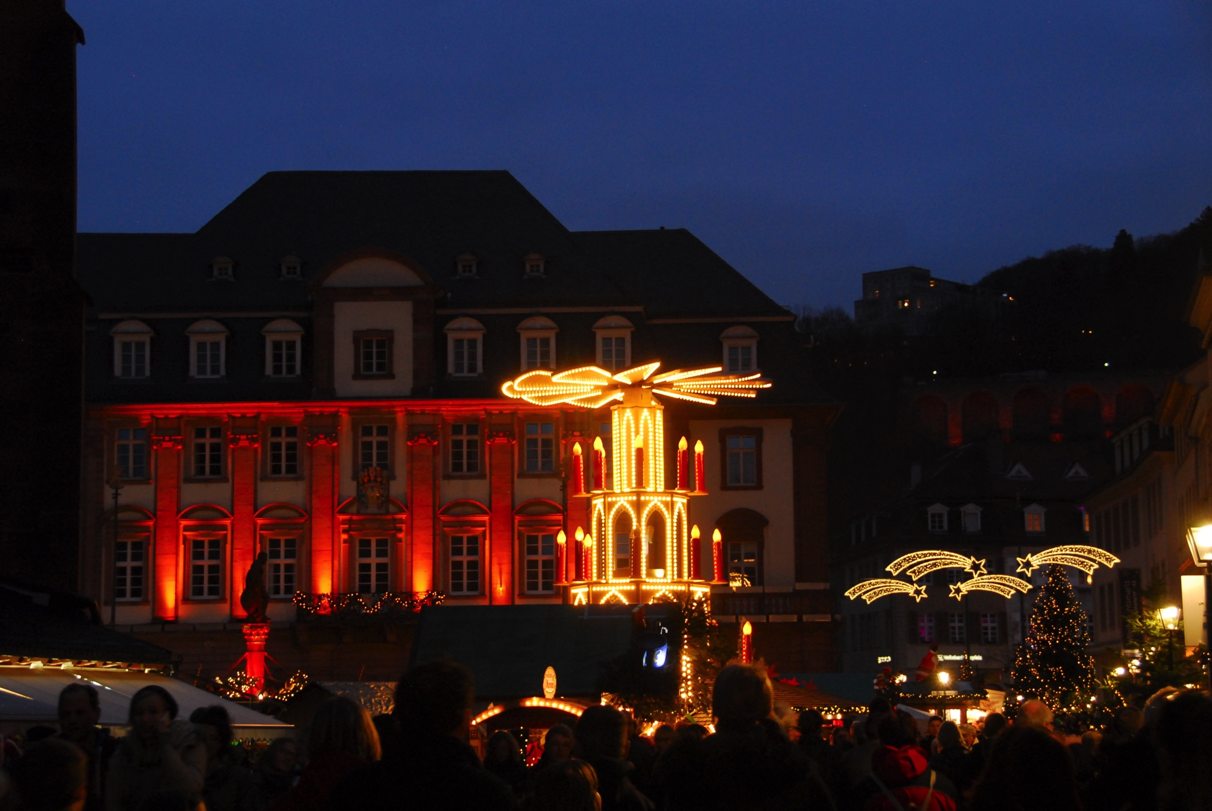

Implications of the pMSSM
J. Hewett, Heidelberg 2015

Slide 2
pMSSM Studies
C.F. Berger, J. Berger, Bloom, Cahill-Rowley, Conley, Cotta, Drlica-Wagner, Funk, Gainer, Ghosh, JLH, Hoeche, Howe, Ismail, Le, Murgia, Rizzo, Wood 0812.0980, 1007.5520, 1009.2539, 1103.1697, 1105.1199, 1111.2604, 1206.4321, 1206.5800, 1211.1981, 1211.7106, 1305.2419, 1305.6921, 1307.8444, 1308.0297, 1309.7653, 1405.6716, 1407.4130, 1407.7021, 1506.05799, 1510.08840, 1512.asap
ATLAS 1508.06608
CMS 1502.02522
AbdusSalam, Allanach, Chourdhury, Quevedo, Feroz, Hobson 0909.2548, 1009.4308, 1106.2317, 1210.3331, 1211.0999
Anandakrishnan 1410.0356
Arbey, Battaglia, Djouadi, Mahmoudi 1110.3726, 1112.3032, 1205.2557, 1207.1348, 1211.4004, 1308.2153, 1311.7641, 1411.2128
Beneke 1411.6930
Bertone etal 1507.07008
Bechtle, Heinemeyer, Stal, Stefaniak, Weiglein, Zeune 1211.1955
Boehm, Dev, Mazumdar, Pukartas 1303.5386
Carena, Lykken, Sekmen, Shah, Wagner 1205.5903
Chakraborti, Chattopadhyay, Chourdhury, Datta, Poddar, 1404.4841
Roszkowski 1411.5214
Sekmen, Kraml, Lykken, Moortgat, Padhi, Pape, Pierini, Prosper, Spiropulu 1109.5119
Strubig, Caron, Rammensee 1202.6244

Slide 3
REMINDER:
SUSY is not a single
model but a very large
theoretical framework
SUSY
N=1
MSSM
pMSSM
NMSSM
singlinos
U(1)’
CMSSM
Rizzo

Slide 4

The pMSSM Model Framework
The phenomenological MSSM (pMSSM)
  Most general CP-conserving MSSM with R-parity
  Minimal Flavor Violation, First 2 sfermion generations are degenerate w/ negligible Yukawas
  No GUT, SUSY-breaking, high-scale assumptions!
  19/20 real, weak-scale parameters (Neutralino/Gravitino LSP)
  scalars:
m_{Q1}, m_{Q3}, m_{u1}, m_{d1}, m_{u3}, m_{d3}, m_{L1}, m_{L3}, m_{e1}, m_{e3}
  gauginos: M₁, M₂, M₃
  tri-linear couplings: A_{b}, A_{t}, A_{τ}
  Higgs/Higgsino: μ, M_{A}, tanβ
  (Gravitino: M_{G})
Supersymmetry without Prejudice
Berger, Gainer, JLH, Rizzo 0812.0980

Slide 5
Study of the pMSSM (Neutralino/Gravitino LSP)
Scan with Linear Priors
Perform large scan over
Parameters
100 GeV ≤ m_{sfermions} ≤ 4 TeV
50 GeV ≤ |M₁, M₂, μ| ≤ 4 TeV
400 GeV ≤ M₃ ≤ 4 TeV
100 GeV ≤ M_{A} ≤ 4 TeV
1 ≤ tanβ ≤ 60
|A_{t,b,τ}| ≤ 4 TeV
(1 ev ≤ m_{G} ≤ 1 TeV) (log prior)
Subject these points to
Constraints from:
Flavor physics
EW precision measurements
Collider searches
Cosmology
~225,000 models survive constraints for each LSP type!
~10,000 low fine-tuning, Neutralino sample
Cahill-Rowley etal 1206.4321

Slide 6
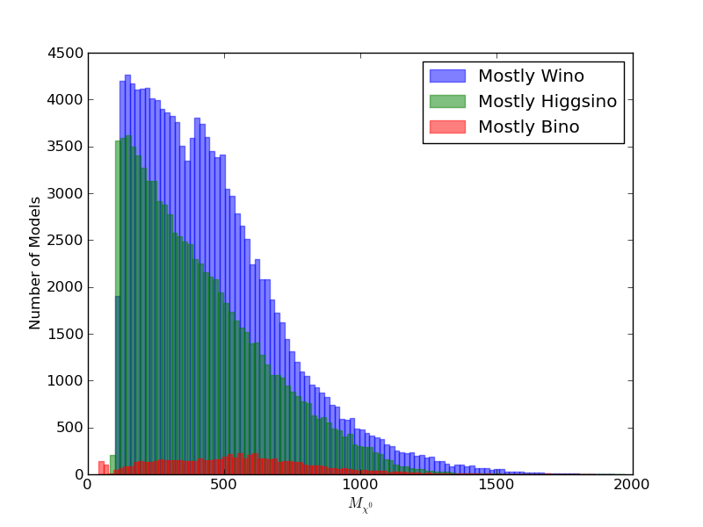
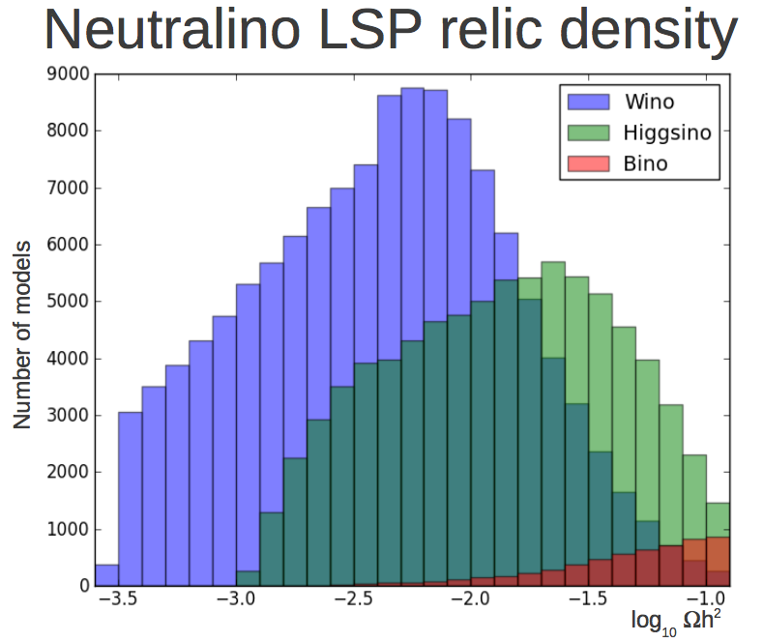
Neutralino Mass Distribution & Relic Density
Employ relic density as an upper bound

Slide 7
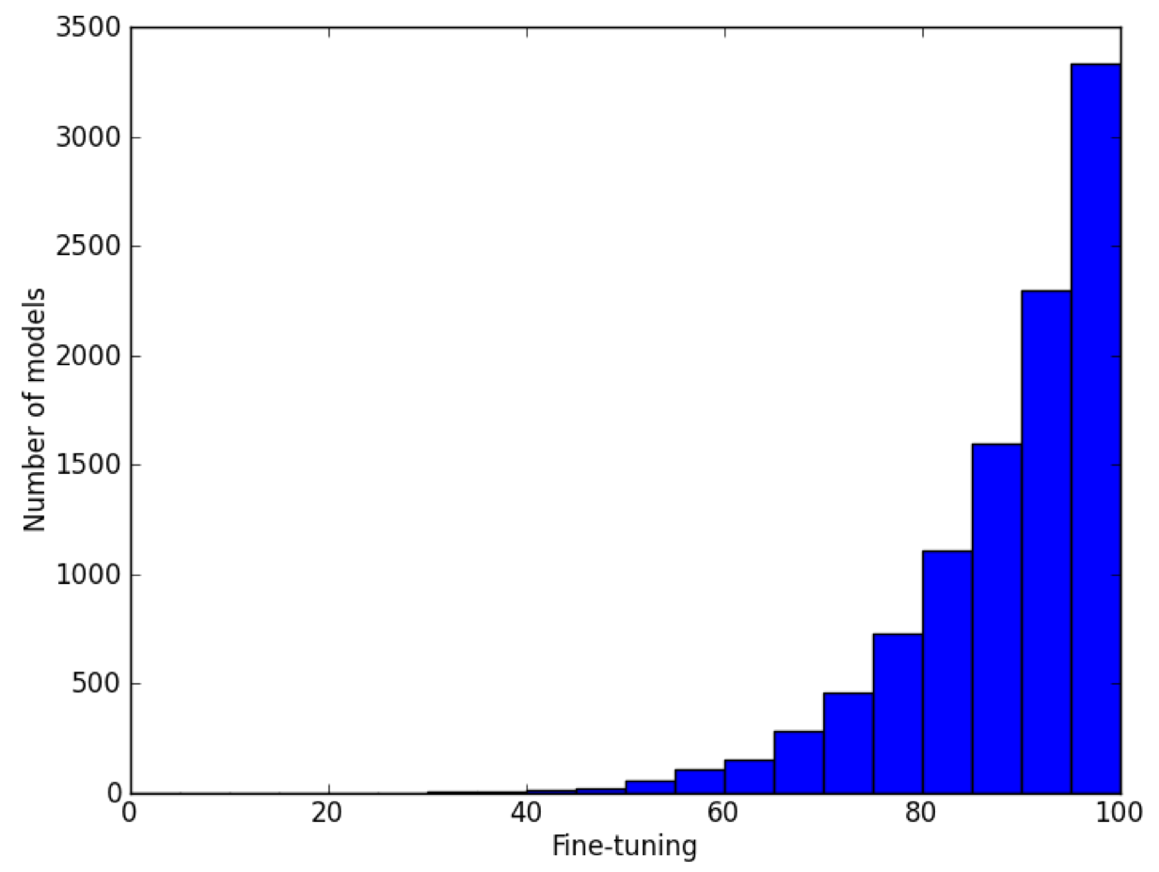
Low Fine-Tuned pMSSM Model Sample
Barbieri-Giudice formulism
m_{h} =126 ± 3 GeV
Ωh² = 0.1153 ± 0.095
Δ

Slide 8

ATLAS MET-based SUSY Analyses
@ 7 & 8 TeV
Apply the LHC SUSY MET-based searches to our model sets (~40 searches from Run I)
We (almost) exclusively follow the ATLAS analysis suite as
closely as possible with fast MC (modified versions of PGS,
Pythia, SoftSUSY(/Suspect), SDECAY, HDECAY)
Generate signal events for every model for all ~90 SUSY processes (~10¹³ events!) & scale to NLO with Prospino
Validated our results with ATLAS benchmark models
We combine the various analyses signal regions (as ATLAS
does) into : nj0l, multi-j, nj1l, nj2l and quote the coverage
for each as well as the combined result..
This approach is CPU intensive!!

Slide 9
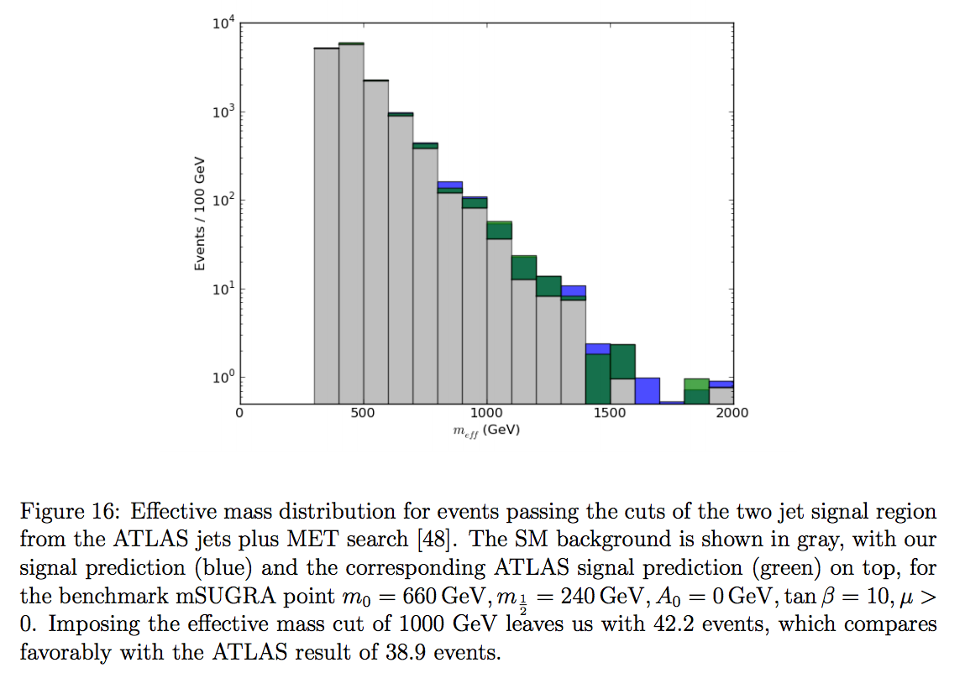
Benchmark Validation

Slide 10
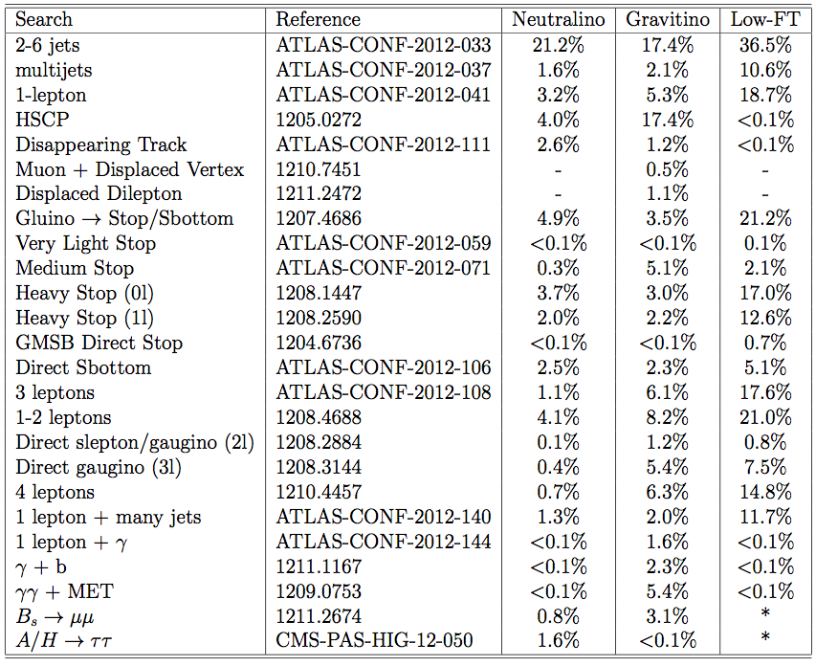
LHC Search Results for the pMSSM: percentage of models excluded by data
7 TeV Searches

Slide 11
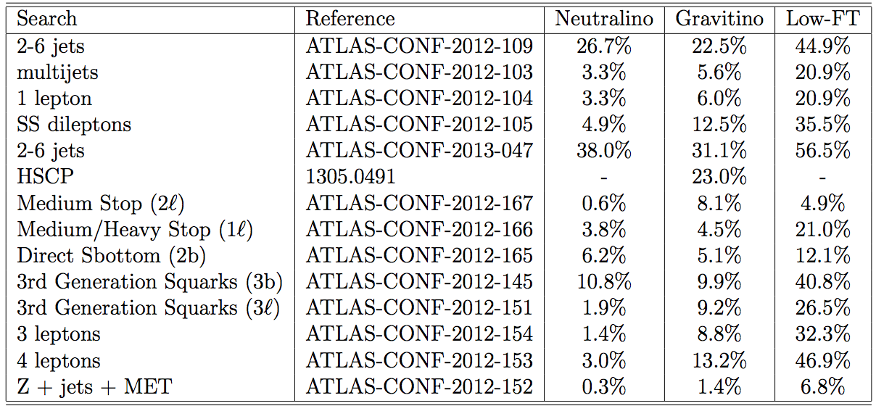
LHC Search Results for the pMSSM: percentage of models excluded by data
8 TeV Searches
Total Excluded 7+8 TeV 46% 61% 74%
Cahill-Rowley etal, 1307.8444, 1405.asap

Slide 12
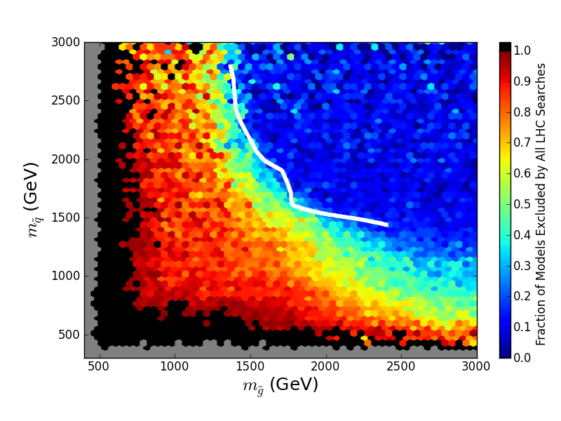
pMSSM after LHC Run I (Neutralino LSP)
Fraction of models excluded
Light Squarks/Gluinos still allowed!
3-parameter Simplified Model does NOT provide a good approximation
Lightest squark mass
Gluino mass
Simplified Model Limit (ATLAS)
Cahill-Rowley, JLH, Ismail, Rizzo
1407.4130

Slide 13
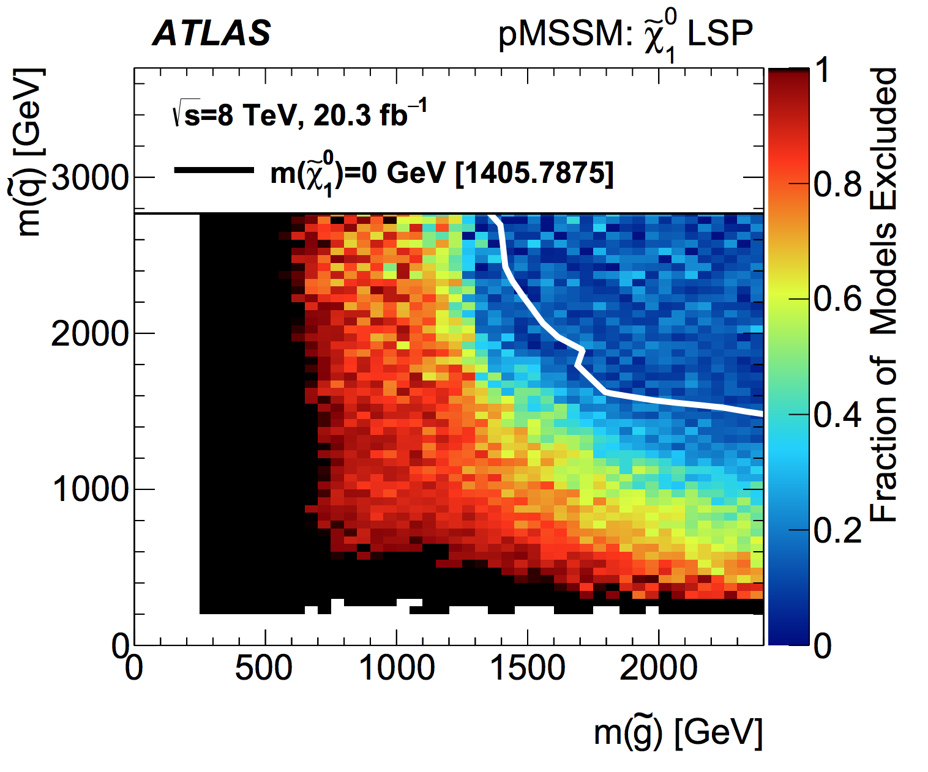
ATLAS Results for the pMSSM (Neutralino LSP)
Recent ATLAS analysis
Combines all Run I SUSY searches
Is it live or is it memorex?
Lightest squark mass
Gluino mass
1508.06608

Slide 14
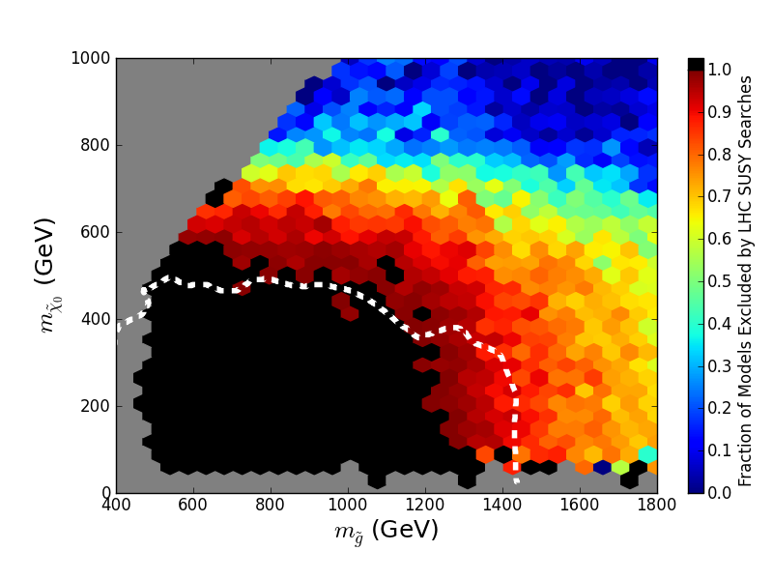
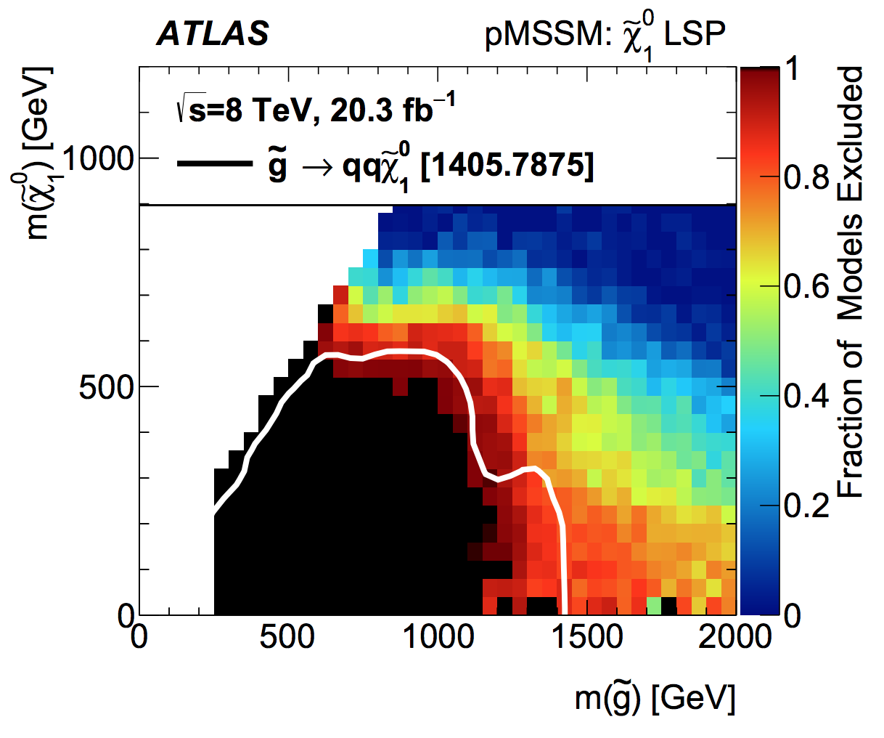
pMSSM after LHC Run I (Neutralino LSP)
Cahill-Rowley etal, 1407.4130
1508.06608
LSP mass
Gluino mass
Simplified Model Limit (ATLAS)

Slide 15
pMSSM after LHC Run I (Neutralino LSP)
Fraction of models excluded
Compressed Spectra
Stealth SUSY
- Complicated decay
chains
Kinematics
LSP mass
2-parameter Simplified Model provides good approximation
Gluino mass
Simplified Model Limit (ATLAS)
Cahill-Rowley etal, 1407.4130

Slide 16
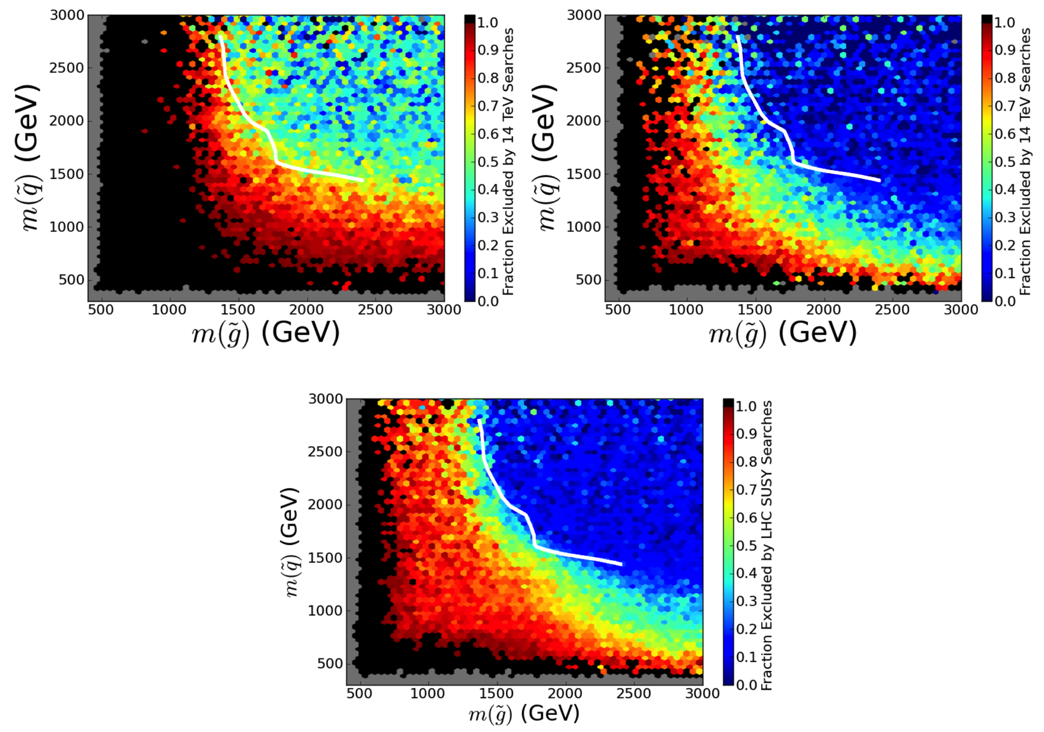
pMSSM after LHC Run I (Gravitino LSP)
Prompt NLSP decay
Displaced NLSP decay
Neutralino LSP
Cahill-Rowley etal 1512.asap

Slide 17
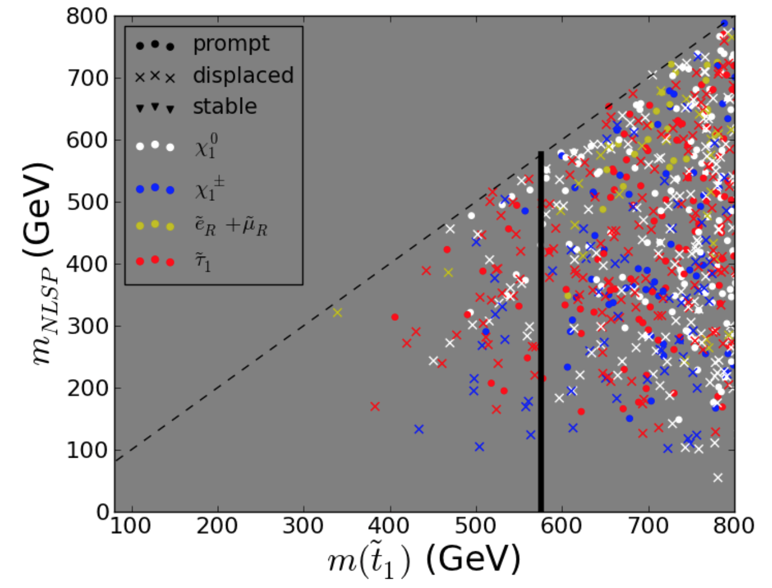
pMSSM after LHC Run I (Gravitino LSP)
Breakdown of
surviving
neutral NLSP
properties
Simplified
Model limit
for massless
LSP
Cahill-Rowley etal 1512.asap

Slide 18
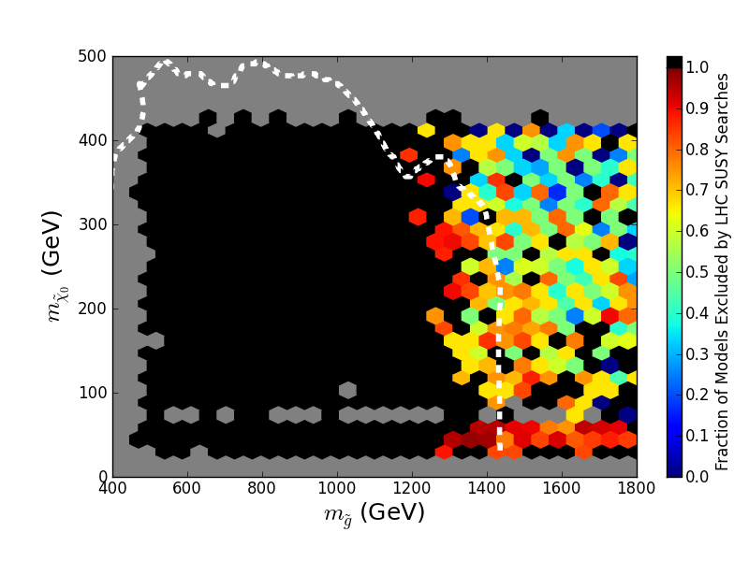
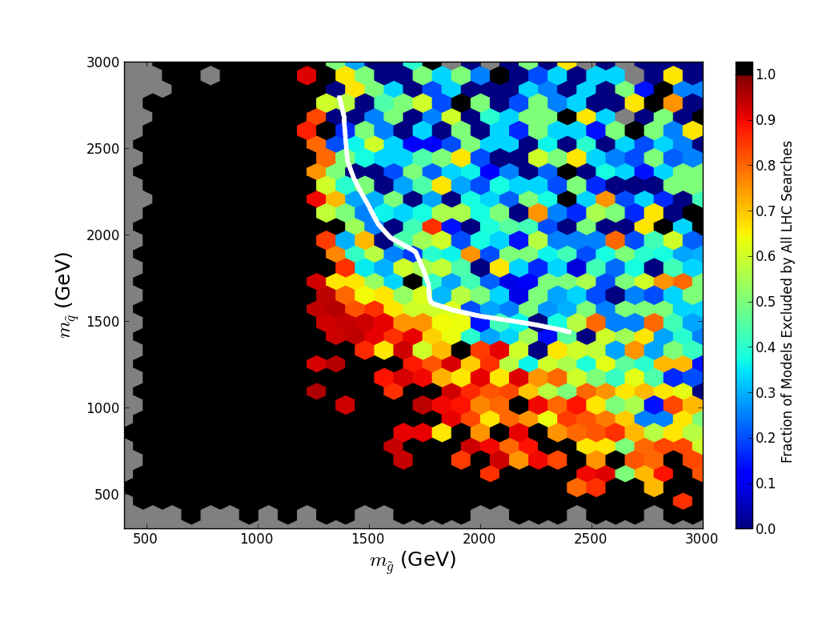
Effects of LHC Searches on Low Fine-Tuning, Neutralino LSP Sample

Slide 19
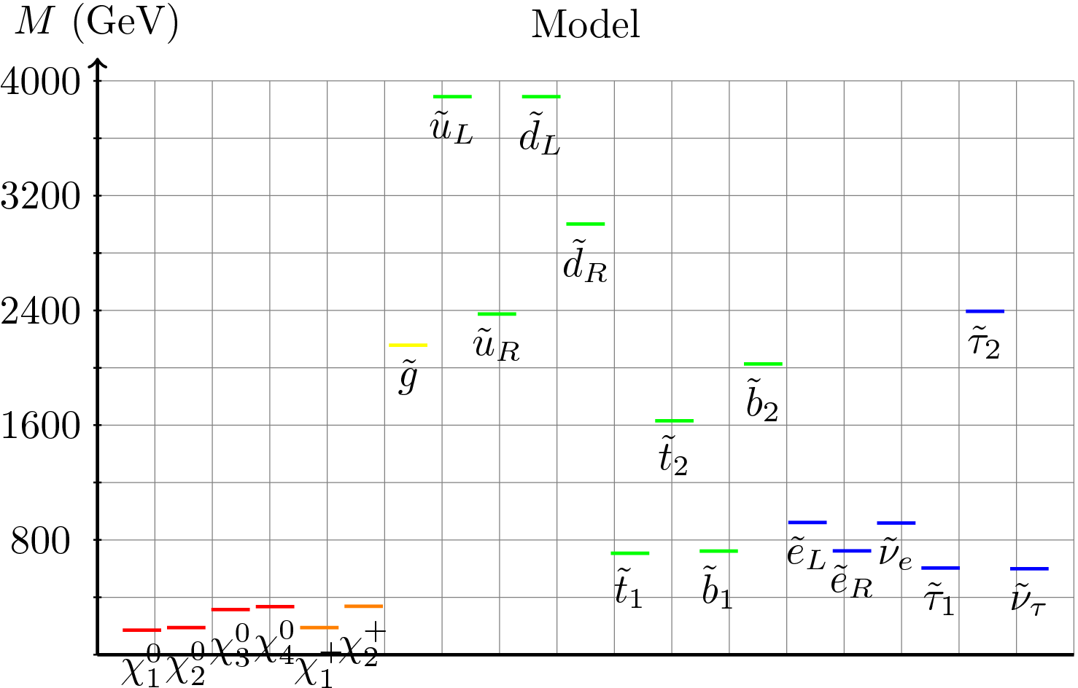
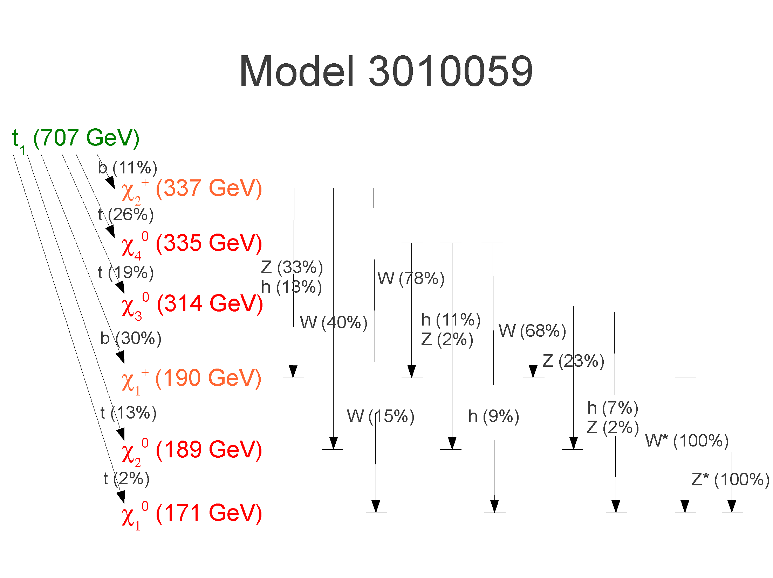
pMSSM Low Fine-Tuning Sample Spectrum
Light stop/sbottom
Suite of light EW gauginos
Complex stop decays evade SUSY searches

Slide 20
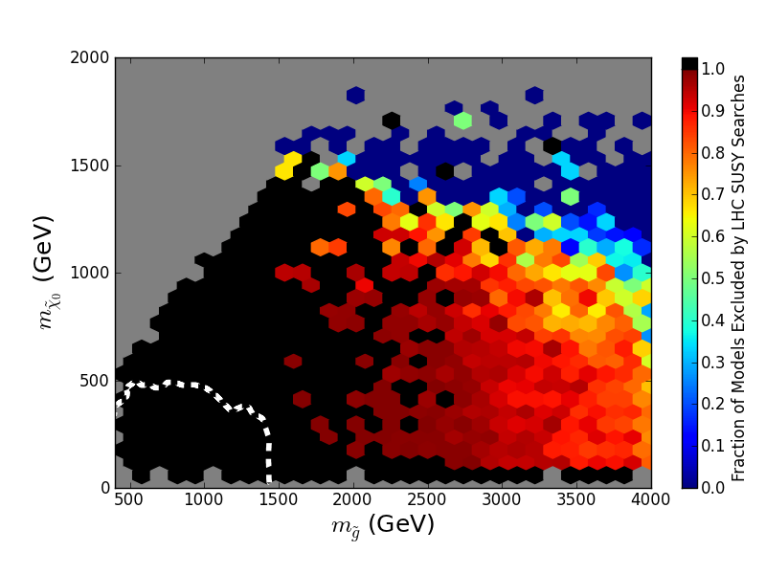
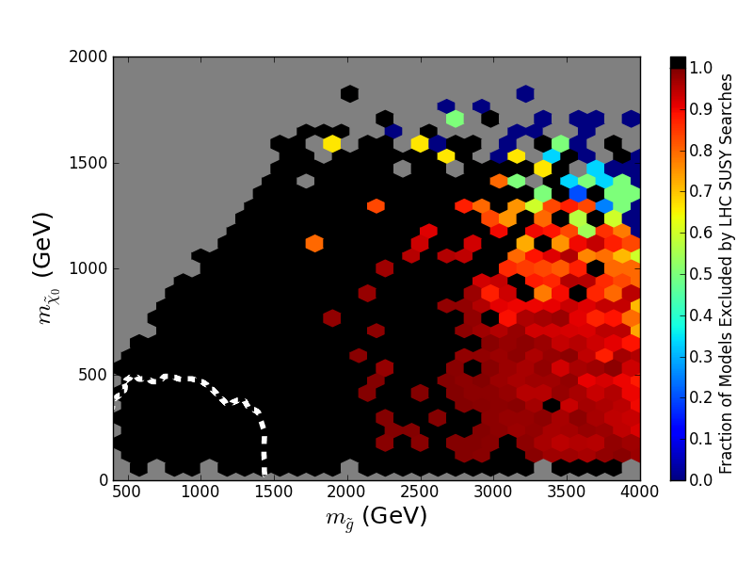
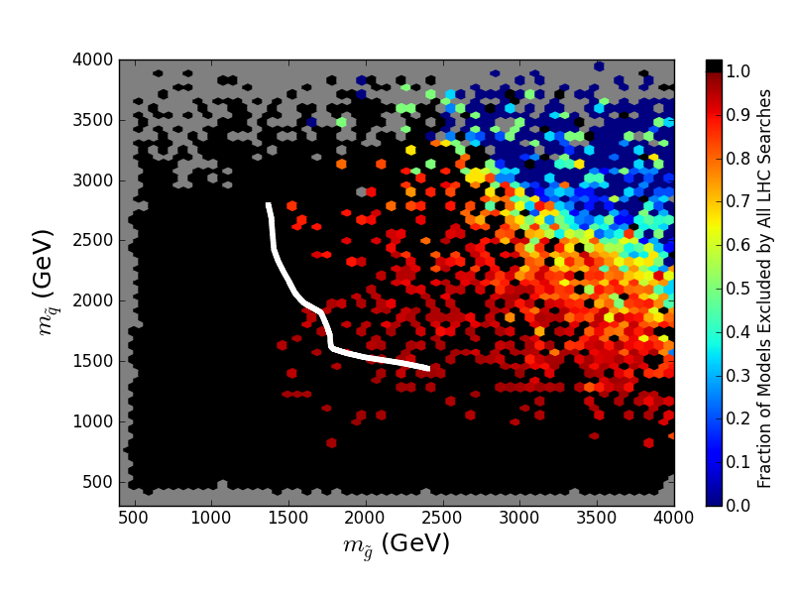
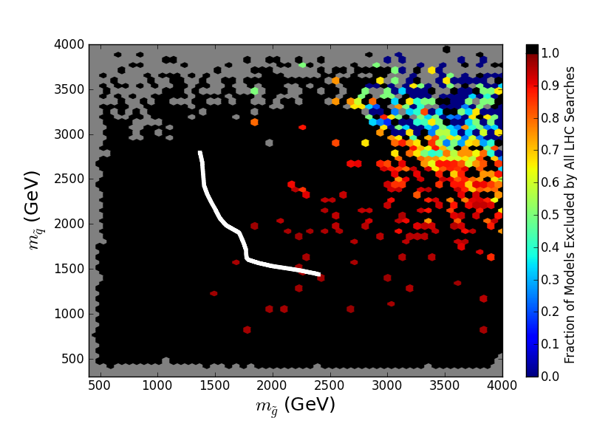
pMSSM Expectations for 14 TeV (Neutralino LSP)
Jets+MET & Stop Search Simulations (ATLAS Snowmass studies)
300 fb⁻¹
3 ab⁻¹
1407.4130

Slide 21
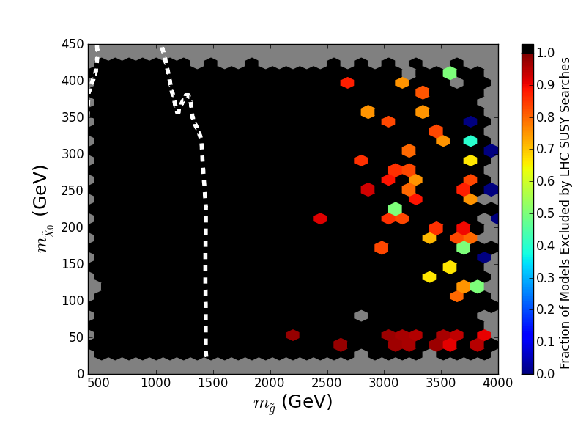
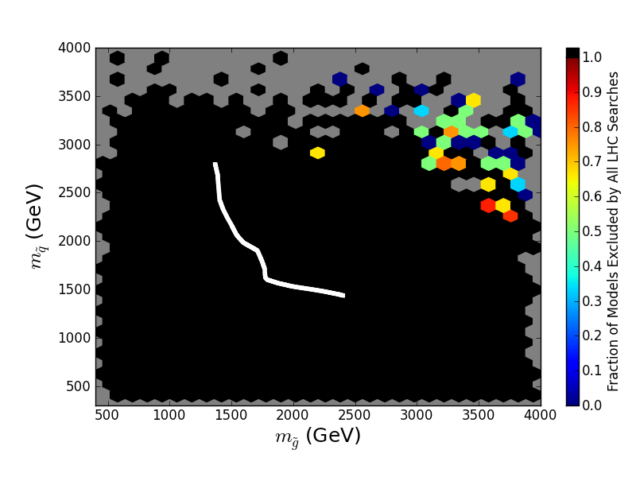
14 TeV LHC pMSSM Coverage for 0.3 & 3 ab⁻¹
Jets+MET Analysis only (ATLAS European Strategy Study)
Stop Search (ATLAS Snowmass Study)
Low-FT model set:
3000 fb⁻¹: 100% models excluded/discovered!
300 fb⁻¹: 97.4% of models excluded/discovered

Slide 22
ATLAS Z+MET Excess
3σ excess in Z+MET channel in ATLAS in Run I
No signal in CMS, but different cuts
Generate sample of simplified models from pMSSM seeds
Successful decay chain satisfying all exp’t bounds:
Squarks ~500-750 GeV; Bino 350 GeV, mass splitting 15-200 GeV with Higgsinos fit the data
Waiting for results from Run II!

Slide 23
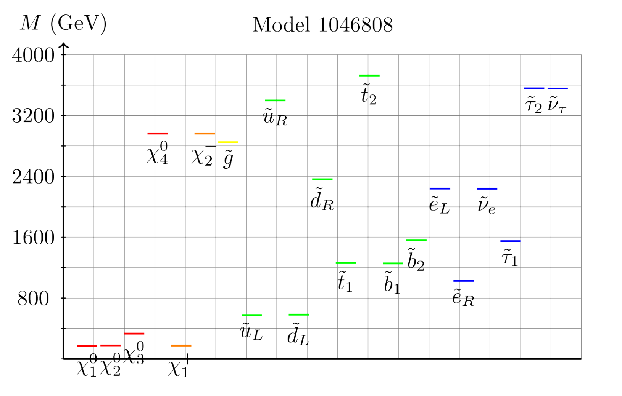
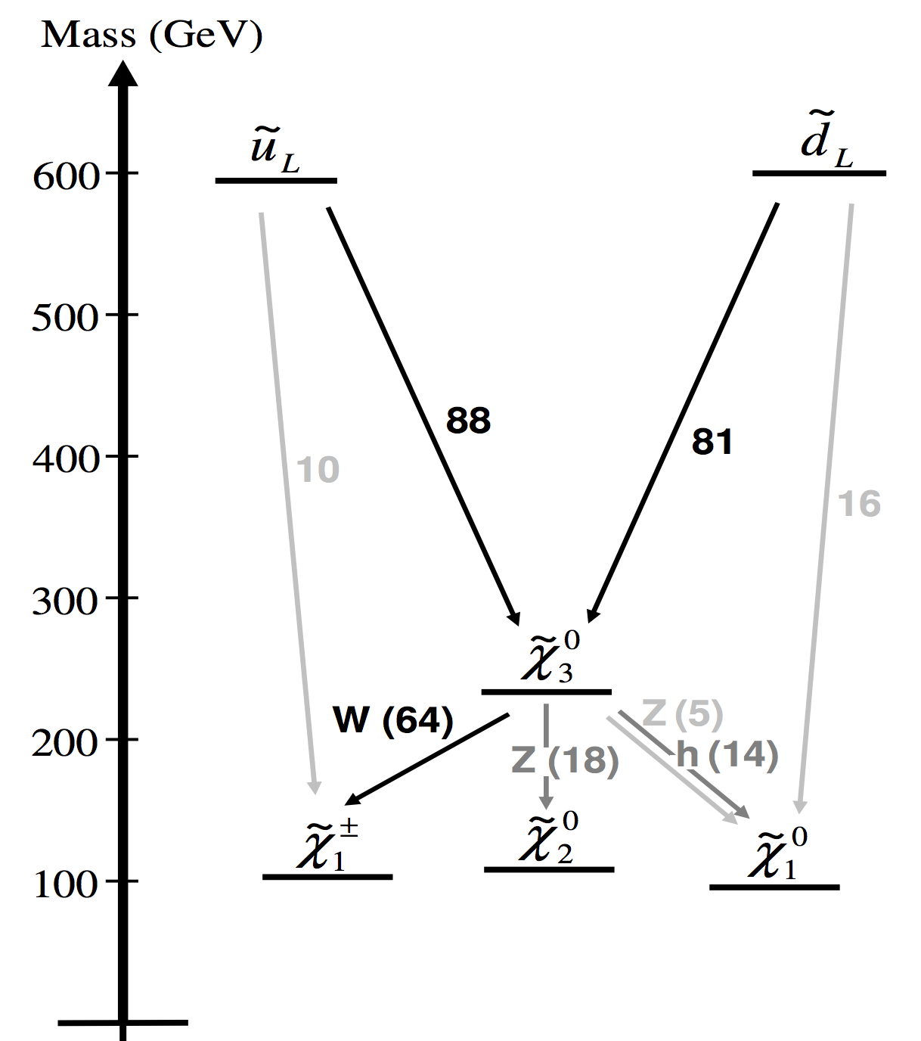
Sample Spectrum

Slide 24
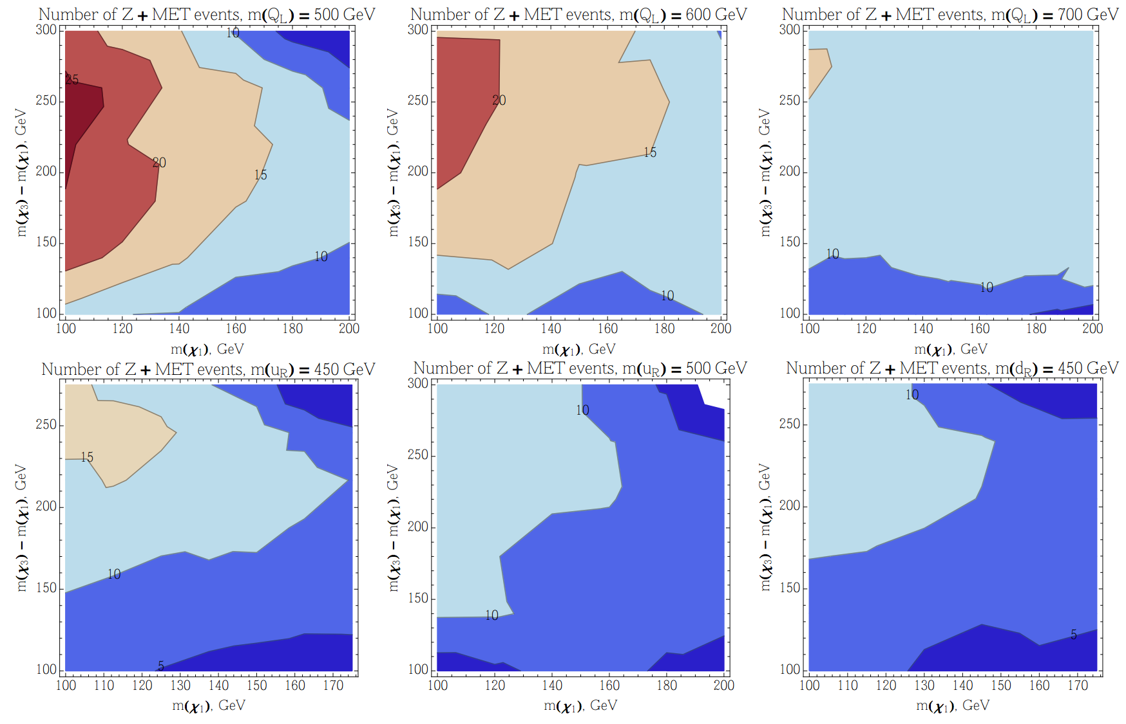
Signal Rate Contours

Slide 25
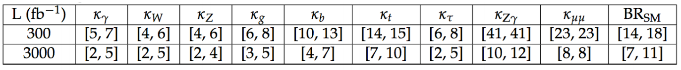
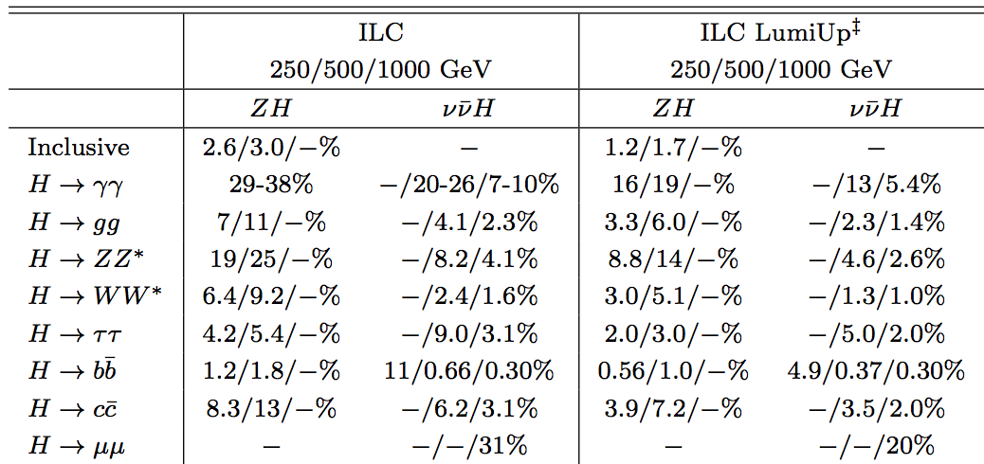
Precision Higgs Measurements
Snowmass Higgs Working Group Report: 1310.8361
CMS: current theory and sys errors: decrease by 2 and √N

Slide 26
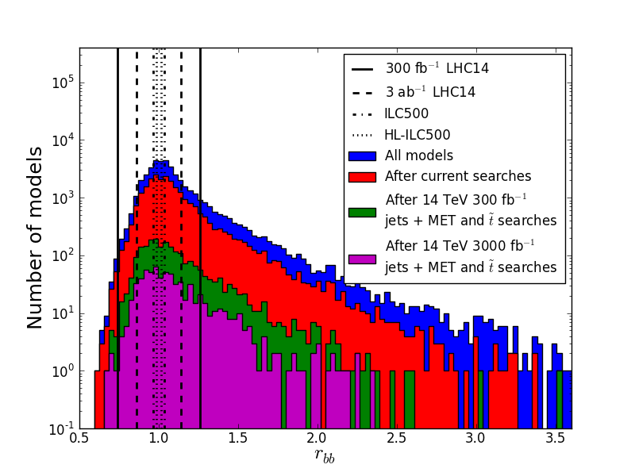
Higgs partial widths in the pMSSM: bb
-
r_{bb}

Slide 27
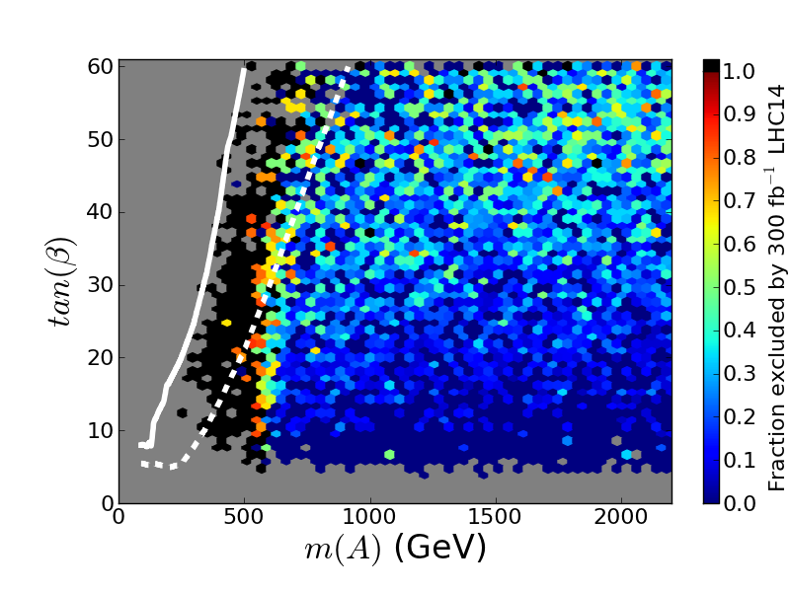
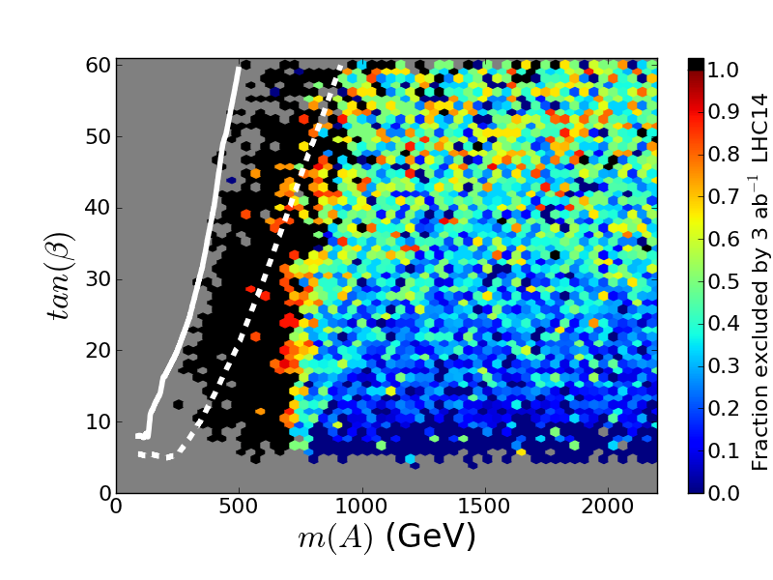
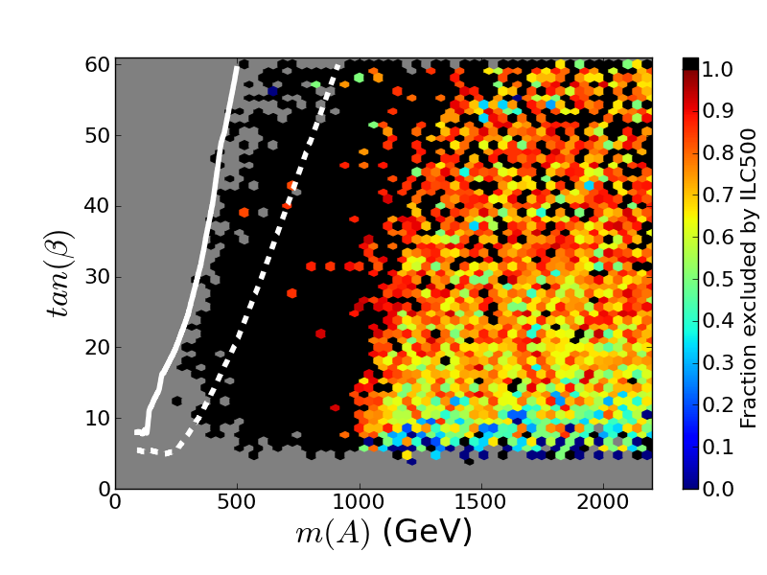
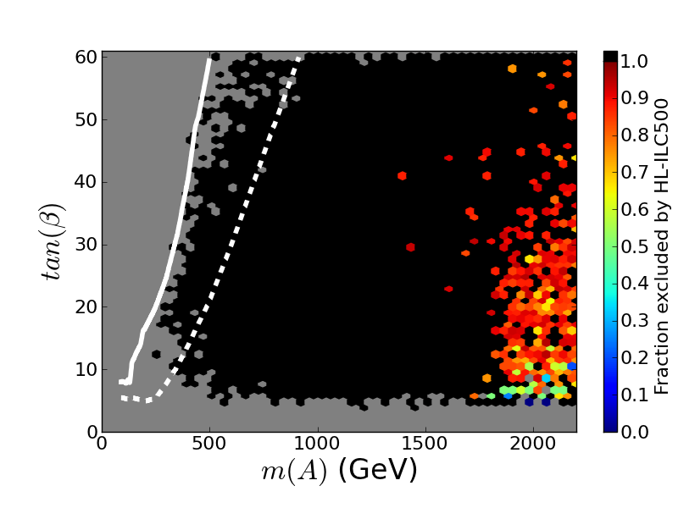
Combined Effect of γγ,ττ, bb Channels
LHC
HL-LHC
ILC
HL-ILC

Slide 28
LHC
qq → χχ
ID
DD
χχ→ qq
qχ→ qχ
Dark Matter Complementarity

Slide 29
Dark Matter Complementarity Study
Ingredients
7 & 8 TeV LHC MET & non-MET → 14 TeV
DD w/ Xenon/LUX & COUPP
ID w/ FERMI & CTA
ICE³
Complementarity
What do these different
experiments say about
the LSP & the pMSSM
in general ?
What happens when
they are combined ?
Cahill-Rowley etal, 1305.6921, 1405.6716

Slide 30
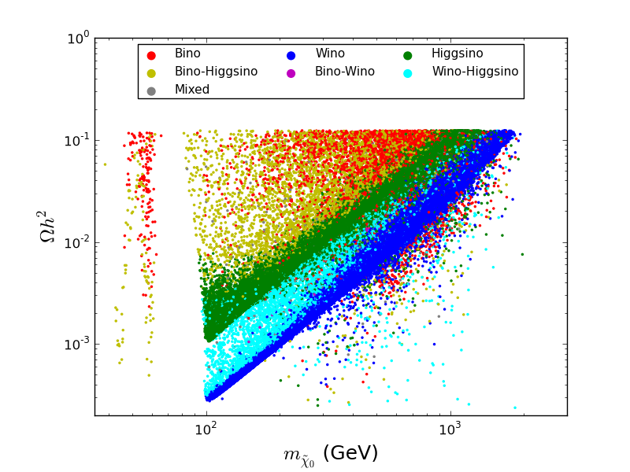
Well-tempered neutralino
Bino co-annihilation
1.7 TeV wino
1 TeV Higgsino
Other annihilations
Bino annihilation through h/Z funnels

Slide 31
Complementarity of Searches
7-8 TeV LHC

Slide 32
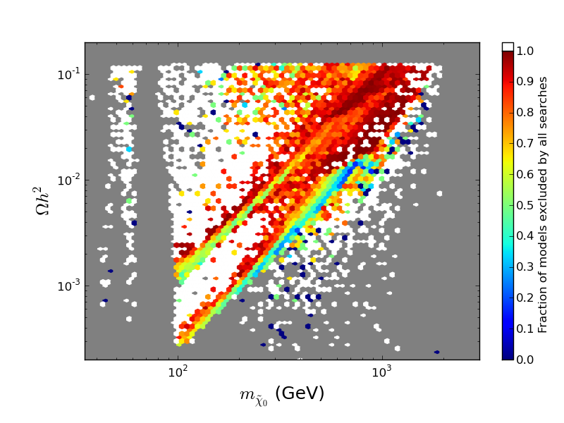
OVERALL Combined Search Efficiency
~61% of models excluded

Slide 33
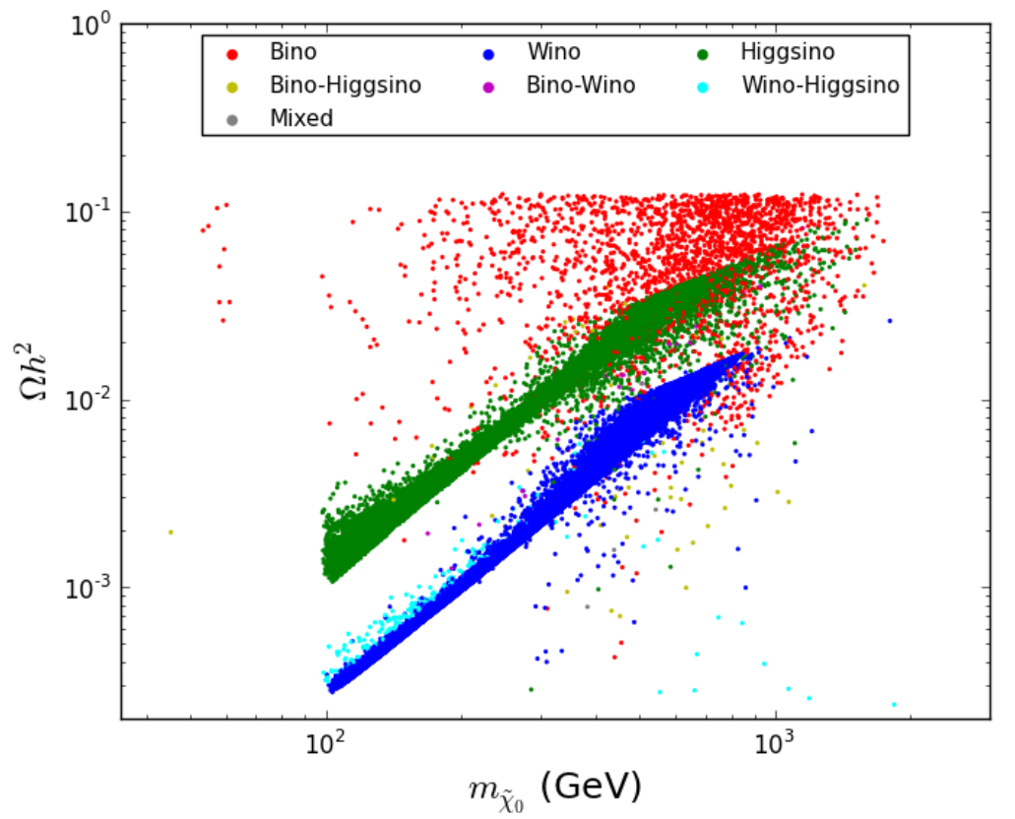
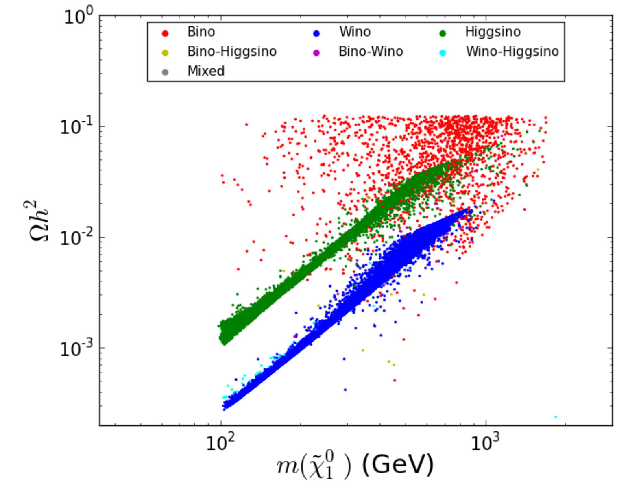
Remaining Model Set
Well-tempered neutralino
Bino co-annihilation
1.7 TeV wino
1 TeV Higgsino
Bino annihilation through h/Z funnels
Other annihilations

Slide 34
Remaining Model Set
Well-tempered neutralino
Bino co-annihilation
1.7 TeV wino
1 TeV Higgsino
Bino annihilation through h/Z funnels
Other annihilations

Slide 35
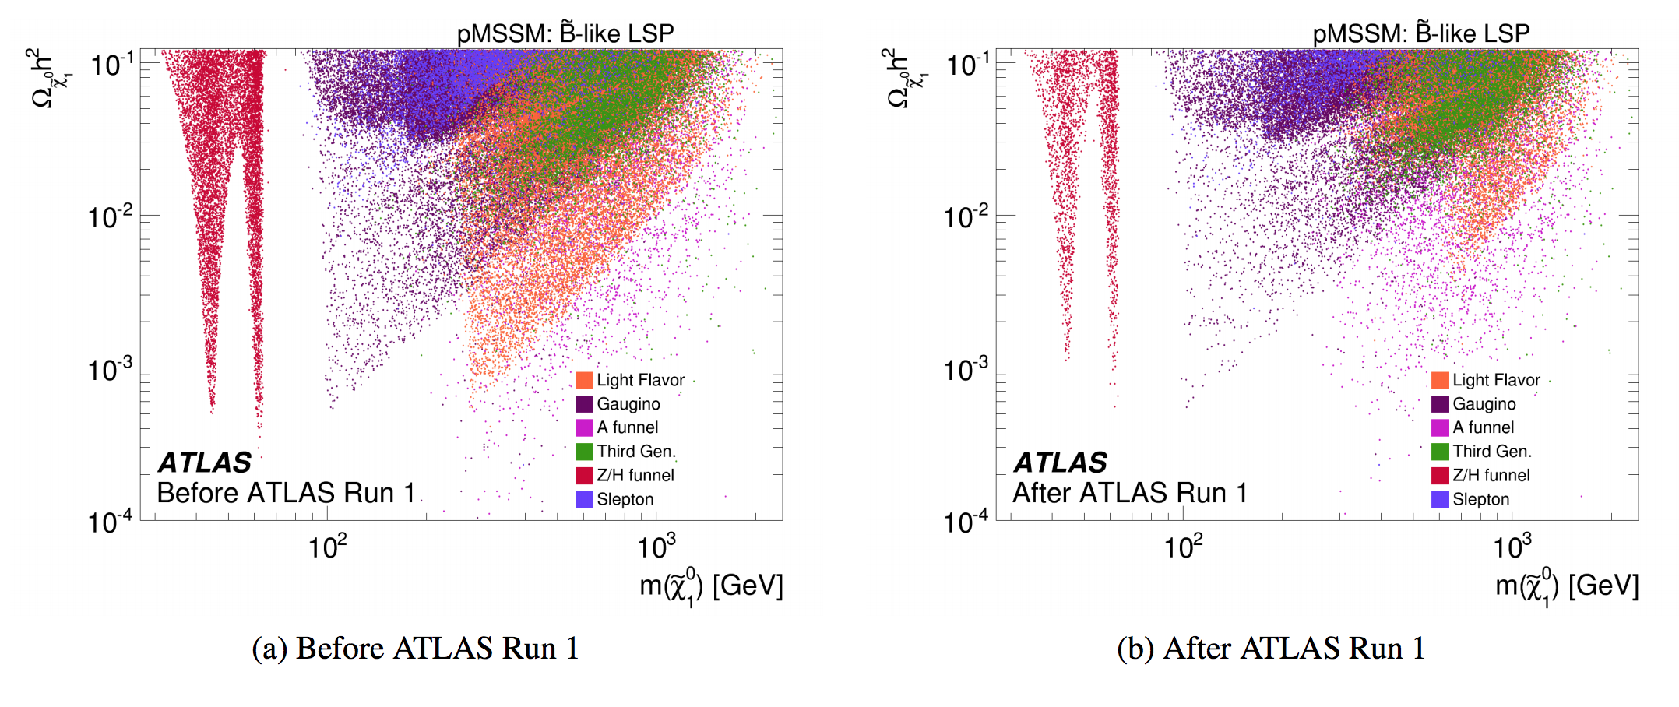
Effects of LHC SUSY Searches on Dark Matter
1508.06608

Slide 36
CP-Violating pMSSM
Expand pMSSM to include CP-Violation
Work in basis where M₃ and B_{μ} are real
➔ Six independent phases allowed in the MSSM
φ₁ = Arg(M₁), φ₂ = Arg(M₂), φ_{μ} = Arg(μ)
φ_{t} = Arg(A_{t}), φ_{b} = Arg(A_{b}), φ_{τ} = Arg(A_{τ})
Take 1000 pMSSM models from previous scan
  500 observable @ LHC14 with 300 fb⁻¹
  500 not observable @ LHC14 with 3 ab⁻¹
For each model, perform 10³ scans over phases in the range 10⁻⁶ π/2 – π/2 (log priors w/ random sign)
Total 10⁶ models with CPV
Examine effects in CP-conserving and CP-violating flavor observables via SUSY_FLAVOR*
  Little impact in LHC direct searches
Berger etal, 1510.08840

Slide 37
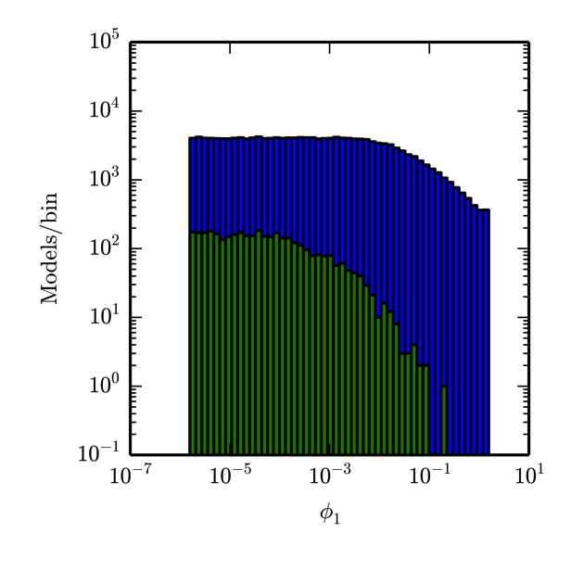
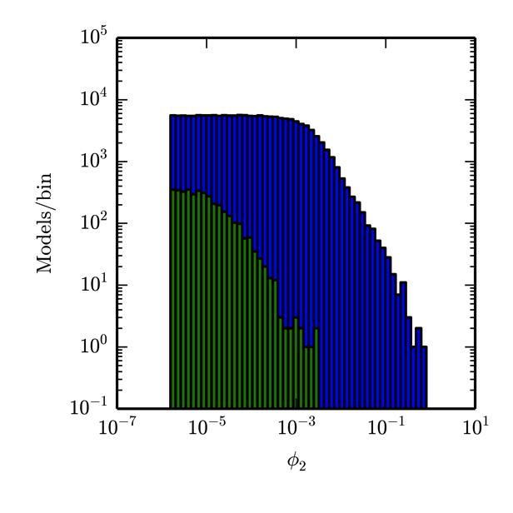
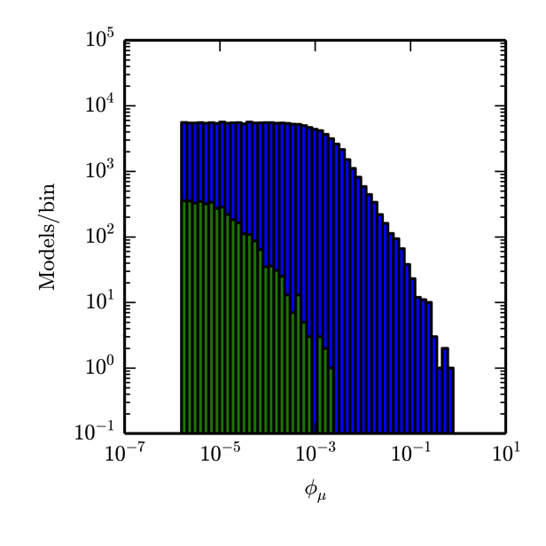
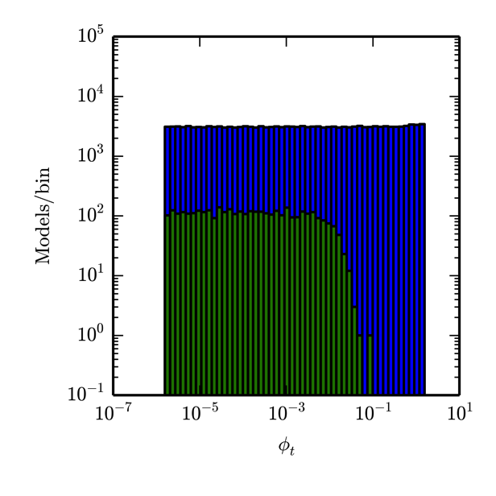
Allowed Ranges of Phases
Current/Future Flavor & CP Constraints

Slide 38
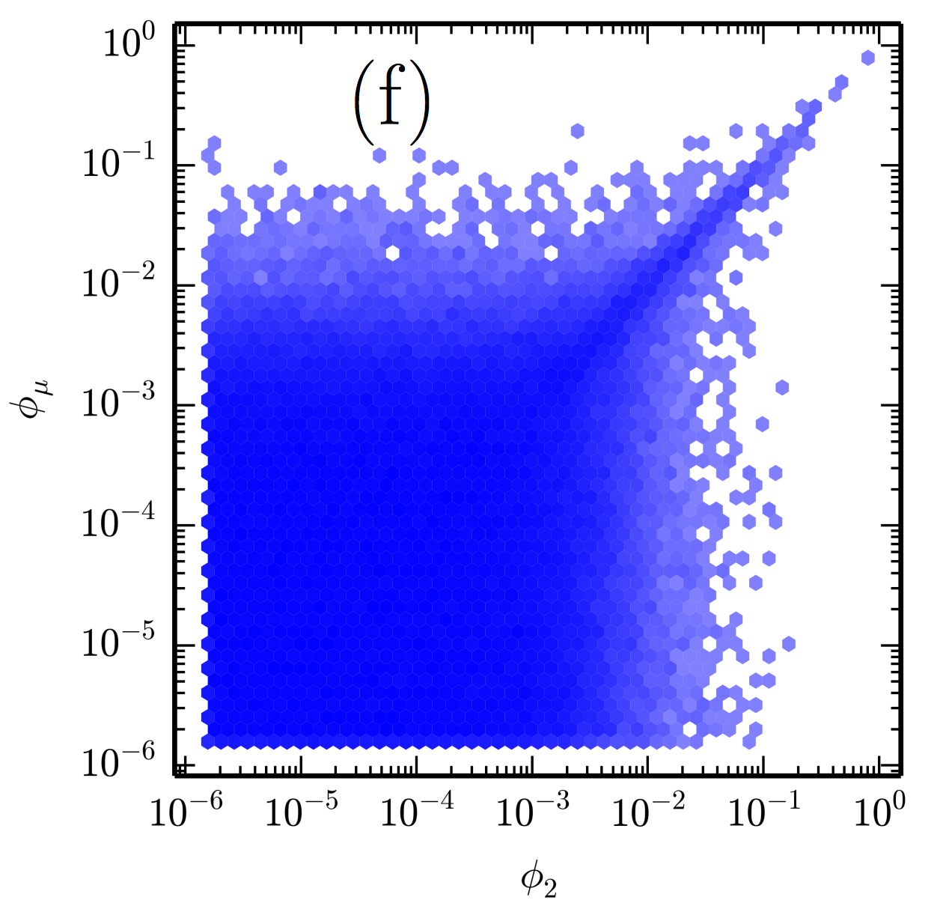
Allowed Ranges of Phases

Slide 39
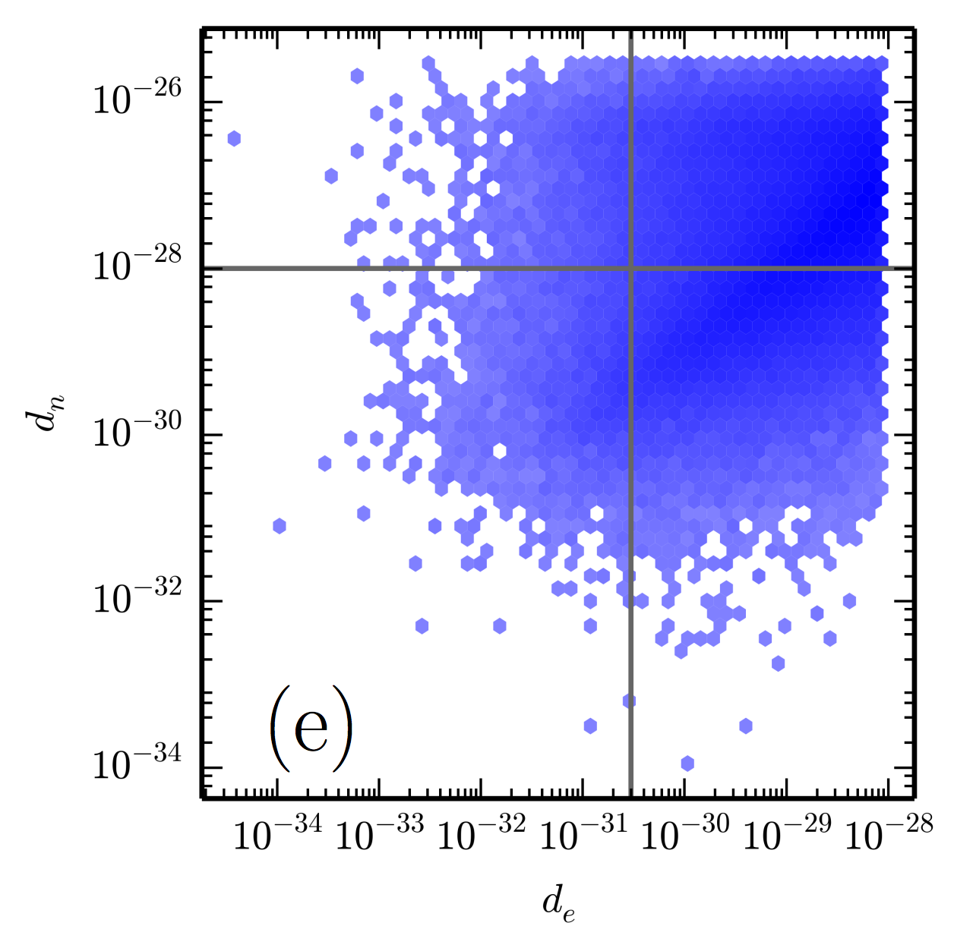
Constraints from EDMs

Slide 40
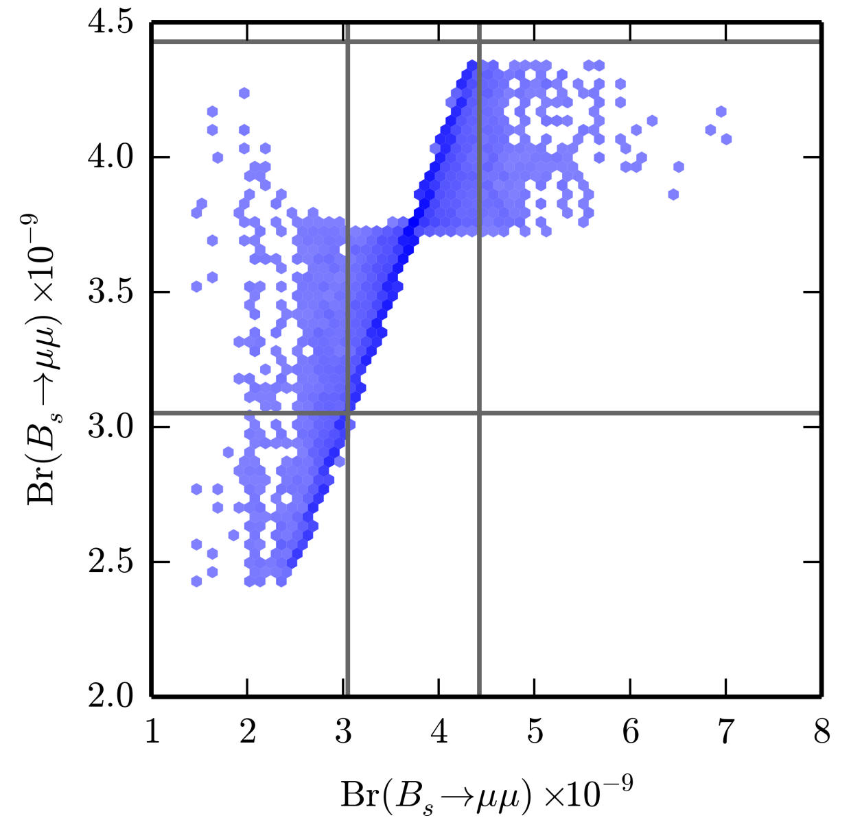
Effects of Phases in B_{s} ➔μμ
With CPV
Phases can pull
BR towards
SM value
No CPV

Slide 41
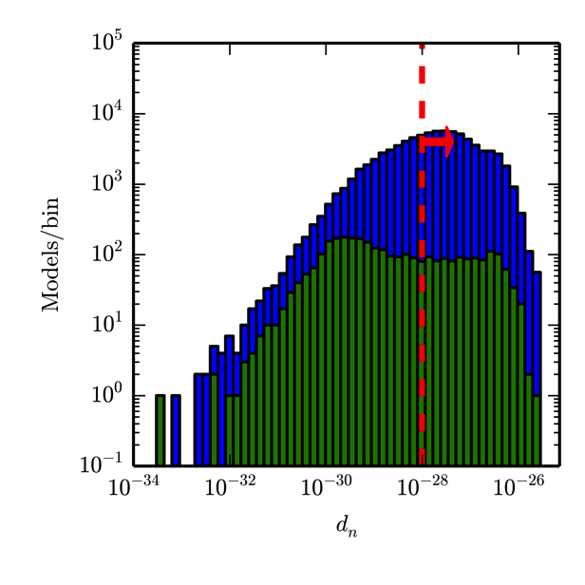
Flavor Observables vs LHC
Set of pMSSM
models not
observed at
LHC14
with 3 ab⁻¹
Green: Models
Remaining after
future flavor
measurments

Slide 42
Conclusions
pMSSM provides excellent playground to study SUSY
Strong bounds from LHC (and Dark Matter) searches
  Lighter squarks/gluinos still allowed
  13 TeV LHC will probe Natural SUSY @ ~95% level
Precision Higgs Measurements are important
  Can probe models missed directly at 13 TeV LHC
Reasonable fine-tuning ~1% is possible
  Selects region of parameter space
  Light stop/sbottom
  Very light and compressed EW-ino sector: good for ILC
All approaches to Dark Matter searches are important for probing the parameter space
Flavor Physics provides a valuable probe
  Can probe models missed by 13 TeV LHC

Slide 43
Backup

Slide 44
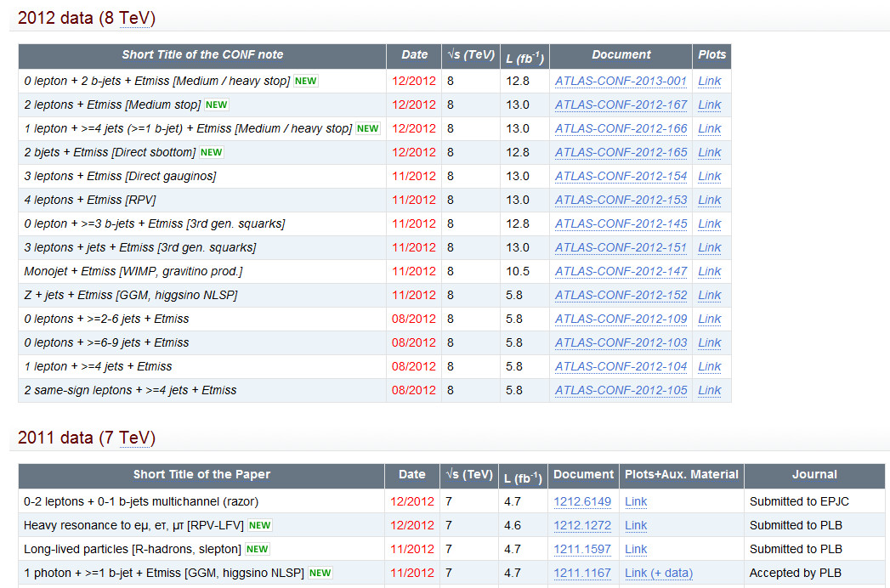
Employ all publically released ATLAS analyses since Moriond13 + 21 fb⁻¹ jets+MET
✓
X
X
CMS
✓

Slide 45
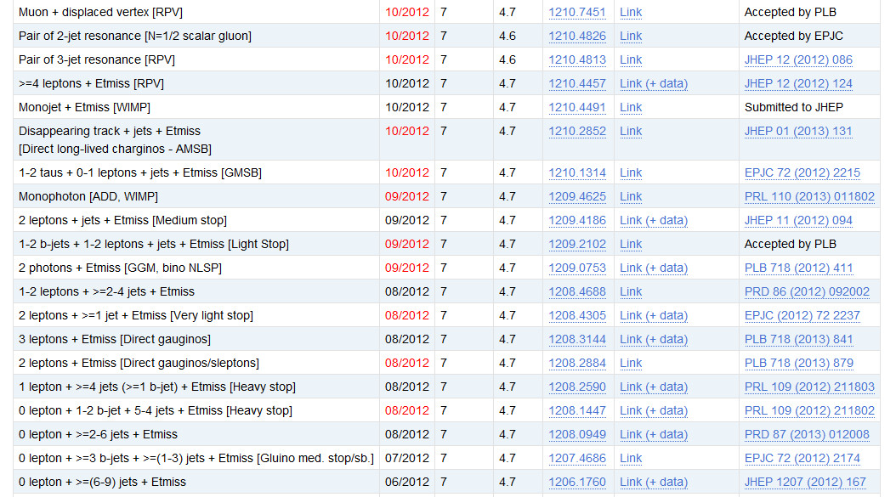
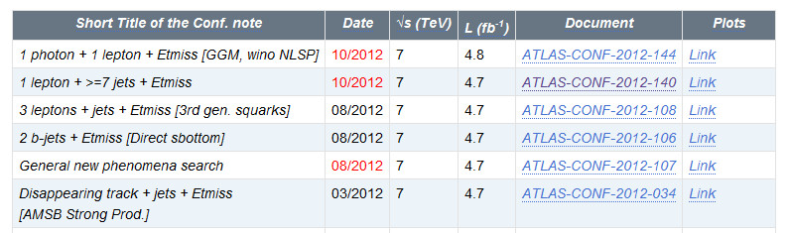
✓
X
✓
X
✓
✓
✓
✓
✓
✓
✓
✓
✓
✓
✓
✓
✓
✓
✓
✓
21 fb⁻¹ jets+MET
In progress

Slide 46

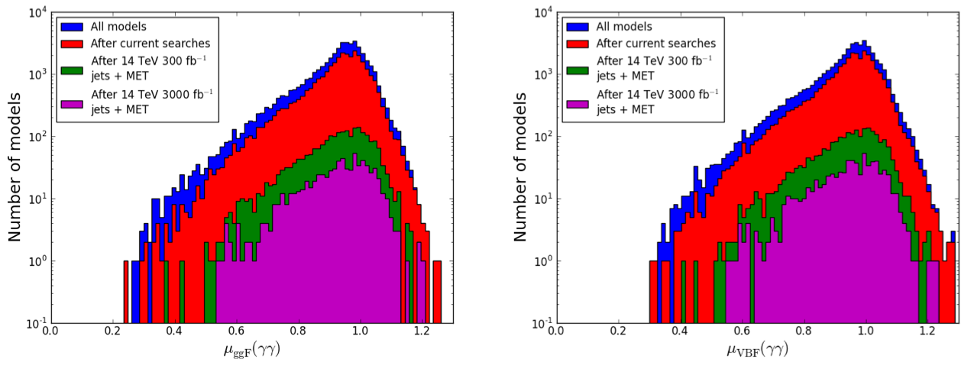
Higgs Diphoton Signal Strength
Cahill-Rowley etal, 1308.0297, 1407.7021

Slide 47
Full List of Model Constraints
Δρ / W-mass
Γ(Z→ invisible)
Δ(g-2)_{μ}
b →s γ
Meson-Antimeson Mixing
B→τν
B_{s}→μμ
Direct Detection of Dark Matter (SI & SD)
WMAP Dark Matter density upper bound
BBN energy deposition for gravitinos
Relic ν’s & diffuse photon bounds
LEP and Tevatron Direct Higgs & SUSY
searches
LHC stable sparticle searches
No tachyons or color/charge breaking
minima
Stable vacua

Slide 48

Higgs Mass Effect on LHC MET-based Searches
The MET-based searches are roughly independent of the of the Higgs mass: the predicted mass of the Higgs is roughly independent of the searches

Slide 49


Effects of LHC Searches on Neutralino LSP Sample

Slide 50


Effects of LHC Searches on Neutralino LSP Sample

Slide 51

Effects of LHC Searches on Neutralino LSP Sample

Slide 52

Complementarity of Searches

Slide 53




‘All-But’ Survivor Density Distributions

